Slide 1
Check & Connect
Te Hononga
Notes:
These slides are intended to help induct kaihoe (mentors) and kaiurungi (coordinators) into Check & Connect: Te Hononga. They are organised into four parts / sessions, each with a suggested audience and learning intentions. However, you are encouraged to use the slides flexibly, selecting slides that suit your purpose and the people with whom you are working, and organising them as you see fit. You can also edit and add to individual slides.
The four sections are:
Section 1: A joint introductory session for kaiurungi and kaihoe
Section 2: A further session for kaiurungi
Sections 3 & 4: Two further sessions for kaihoe.
In each section, at least one video is used in an activity. The videos require an internet/wi-fi connection with good bandwidth to play. If this isn’t available, you’ll need to download the videos you require ahead of time from https://pb4l.tki.org.nz/Check-Connect.
Set the tone for each session by ensuring the comfort of participants and showing them respect and consideration. That includes:
communicating clearly about where and when you will meet
ensuring the venue is comfortable and accessible
learning about and addressing any personal needs (e.g., regarding childcare and transport)
having the resources you need ready for use; these include activity sheets, sticky notes, large sheets of paper, marker pens, and biros
letting people know where the toilets are and what to do in an emergency
opening proceedings with a karakia timatanga belonging to the hau kāinga (home people)
sharing kai and saying a karakia kai before eating
sticking to the time allowed
visibly recording any questions or ideas that cannot be immediately addressed
ensuring everybody has a copy of the manual and regularly referencing it so that they become familiar with its contents and the degree of guidance provided.

Slide 2
Check & Connect: Te Hononga
Section 1:
Introduction
Notes:
This is a joint session for kaiurungi (coordinators) and kaihoe (mentors). It lasts for 1.5 to 2 hours.
Welcome attendees to the session.
Explain: Check & Connect: Te Hononga is a two-year mentoring initiative for ākonga who are in the early stages of disengaging from school or at risk of non-attendance altogether. It originated at the University of Minnesota and has been adapted for the Aotearoa New Zealand context by the Ministry of Education. It is part of the Ministry’s Positive Behaviour for Learning (PB4L) suite of initiatives that support ākonga wellbeing and learning.
Thank the attendees for coming and acknowledge them for their caring and commitment in taking on roles within this important initiative. Presumably, they already know something about it – today, they will have the opportunity to learn more about it and about what will be expected of them and how they will be supported.

Slide 3
Purpose of this session
The purpose of this session is for you to learn about:
why it is important to address ākonga attendance and engagement
the origins and development of Check & Connect: Te Hononga
how Check & Connect: Te Hononga works, and what makes it distinctive
who is involved and what their roles and responsibilities are.
You will also begin to build relationships with some of the people you will be working with.
Notes:
Talk through the purpose.

Slide 4
Who is Check & Connect: Te Hononga for?
Students considered for Check & Connect will be disengaging from learning and be at risk of dropping out.
(Check & Connect: Te Hononga manual, p. 26)
I think the things that worked best for me were seeing someone that I could talk to every week and her checking on my progress and helping me through things I found hard. And she motivated me all the time.
(NZCER 2016 evaluation, p. 41 )
Notes:
Explain
Check & Connect: Te Hononga is intended for ākonga who show signs of disengaging from education and are at risk of non-attendance. Identifying ākonga who could benefit from the initiative requires us to have a good understanding of what disengagement looks like, the factors that put an ākonga at risk, and the protective factors that make disengagement less likely.
In later sessions, we’re going to conduct some activities to help develop shared understandings about risk factors and protective factors, and how to identify ākonga at risk of disengagement. We’ll also show you some tools to help you in this process.
Right now, the important thing to know is that we work hard to ensure the ākonga involved in Check & Connect: Te Hononga are those who are most likely to gain from it.

Slide 5
How does Check & Connect: Te Hononga work?
A two-year, contextualised initiative
Check: Kaihoe (mentors) systematically check on attendance, achievement, and pastoral data to support problem solving.
Connect: Kaihoe connect with ākonga, providing personalised, timely responses to help solve problems, build skills, and enhance their competence.
Hononga: union, connection, relationship, or bond
Notes:
Explain
Mentors meet with ākonga over a period of two years, usually in school but taking account of what is happening for ākonga at home and in the community. They report on progress for ākonga to whānau and the school. The principal and coordinators – kaiurungi – report to the board on progress within the initiative as a whole.
Check & Connect: Te Hononga involves closely monitoring ākonga for signs of disengagement and identifying protective factors and “alterable” factors that can be influenced to make disengagement less likely.
The ‘Check’ in Check & Connect: Te Hononga refers to the process where mentors – kaihoe – systematically monitor attendance, achievement, and pastoral data to support problem solving.
‘Connect’ refers to the way kaihoe connect with ākonga to provide personalised, timely responses intended to help them solve problems, build skills, and enhance their competence.
Prominent educational researchers Sonja and Angus Macfarlane helped develop the manual that guides implementation. They gifted the name ‘Te Hononga’ to the initiative. Te Hononga means “linking, connecting, bringing together”. It’s a name that emphasises the long-term commitment to relationships that is at the heart of the initiative.

Slide 6
Distinctive features of Check & Connect: Te Hononga
A targeted, intensive intervention intended to complement other school initiatives
Structured mentoring, focused on educational performance and learning success
Significantly increases the likelihood that ākonga will stay in school
Three core elements: relationships, problem solving and capacity-building, and persistence.
(Check & Connect: Te Hononga manual, p. 7)
Notes:
Explain
The US developers say that four characteristics make Check & Connect different from other mentor programmes:
It is a targeted or intensive intervention intended to complement other initiatives in the school.
It is a structured mentoring intervention focused on students’ educational performance and success with learning.
It is an empirically supported intervention based on research that shows it significantly increases the likelihood that ākonga will stay in school.
It has three clearly delineated core elements: relationships, problem solving and capacity-building, and persistence.
Christenson et al. (2012), pp. 2–4, cited in the New Zealand manual, page 7
Ask participants to read the section headed “What is Check & Connect” on page 6 of the manual to help reinforce their learning so far.

Slide 7
Activity: The seed of potential
Have people always seen the “seed of potential” in you?
What difference has this made to your life?
What is the impact if we do not recognise the potential in others?
What have you seen of this in schools?
Kei roto i a koe tōu ake mana. Within each of us lies the seed of potential.
Watch: Check & Connect - Working with families
Notes:
Read the whakataukī and explain that this fundamental belief informs all the work of Check & Connect: Te Hononga.
Play the video.
Invite participants to turn to the people sitting next to them and discuss the meaning of the whakataukī. Prompt them to make connections to what they heard in the video and to their own lives, using the questions on the slide. Allow 5 minutes for this discussion, and then invite people to feed back some of their thoughts.

Slide 8
Origins of Check & Connect: Te Hononga
Check & Connect:
was developed by the University of Minnesota in the late 1990s
has been extensively and successfully used in the USA and many other countries
evidence shows that it improves ākonga engagement, attendance, and learning outcomes.
For more information, see the University of Minnesota website.
Notes:
Explain
Check & Connect: Te Hononga was developed by the University of Minnesota in the late 1990s and has been adopted in most US states and many other countries. It’s been subject to evaluation throughout its development.
From this evaluation, there is strong evidence that Check & Connect helps ākonga to:
improve their engagement and retention rates
develop a positive attitude to learning
increase their levels of problem solving
raise their academic performance.
You may want to click on the link in the slide to show the website to people – though the image is probably enough.
To learn more about the research that supports Check & Connect and evaluation results for it, you can go to the University of Minnesota website and click on the ‘Research’ tab.

Slide 9
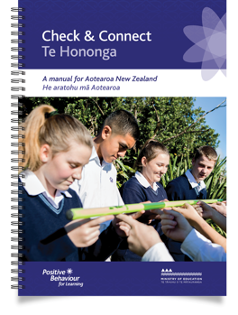
Check & Connect: Te Hononga in Aotearoa
2012: Implemented in several Christchurch schools following the earthquakes
2013–2016: Piloted in 17 schools
2016: NZCER evaluation
2021: Publication of the Check & Connect: Te Hononga manual
Implementation:
is based on evidence about ‘what works’ in Aotearoa New Zealand
attends to inclusion and culturally sustaining practice.
Notes:
Explain the following. As you do so, use the link and your copy of the manual to reinforce the messages that:
the programme has been formally evaluated here in Aotearoa
there is clear guidance for implementation via the manual.
Check & Connect: Te Hononga has been successfully implemented in many countries. In Aotearoa New Zealand, it was:
piloted in Christchurch after the 2010–2011 earthquakes
piloted in 17 secondary schools from 2013–2016
evaluated by NZCER in 2016 – most participating ākonga and their kaihoe reported positive outcomes.
Implementation in Aotearoa NZ closely follows the successful model developed by the University of Minnesota. However, with support from the University, the model has been adapted to the New Zealand context. This collaboration means that we have kept the features that make it work but incorporated features to ensure that it works well for ākonga in our schools. This includes ensuring it is inclusive and culturally responsive.
The Check & Connect: Te Hononga manual is for schools that are considering or planning to implement the initiative. Its major sections cover:
the roles, relationships, and processes involved in implementing Check & Connect: Te Hononga
detailed guidance for mentors
how schools can evaluate their use of Check & Connect: Te Hononga and ensure the initiative’s fidelity.
We will be engaging closely with the manual throughout our sessions.

Slide 10
Honouring Te Tiriti o Waitangi
Notes:
Check & Connect: Te Hononga has a strong emphasis on working collaboratively with ākonga and whānau to strengthen ākonga engagement with education. This means it aligns well with the principles of Te Tiriti – partnership, protection, and participation.
Partnership: requires working with iwi, whānau, and communities to enable ākonga to achieve educational success. Whanaungatanga is at the core of Check & Connect: Te Hononga. Caring, trained kaihoe (mentors) develop trusting relationships with the ākonga and those around them to understand what success looks like and how to achieve it.
Protection: requires the understanding, respect, and support of Māori concepts, values, and practices. Check & Connect: Te Hononga kaihoe work with ākonga in the home, school, and community to strengthen their connection to school.
Participation: requires that Māori be involved in decision making, planning, development, and delivery. Ākonga and whānau are actively involved in setting goals and giving and receiving feedback. By actively participating in authentic learning, ākonga gain a sense of belonging that reduces their chances of non-attendance and increases the chances of educational success.

Slide 11
Why do we in Aotearoa need Check & Connect: Te Hononga?
Attendance is linked to ākonga wellbeing, engagement, and attainment.
Ākonga wellbeing is a key priority of the education system. … Attending school regularly and being engaged predict the best outcomes for wellbeing on average.
Attendance is clearly linked to engagement and attainment in NCEA … There is no “safe” level of non-attendance.
Notes:
Share the following information, which is sourced from the Education Counts Attendance page and the Ministry of Education’s Attendance and Engagement Strategy (June 2022).
In Term 1 2023, the percentage of ākonga who attended school more than 90% of the time had dropped to 59.5%. In contrast, the rate in Term 1 2019 was 72.8%. The Covid pandemic has significantly impacted on attendance.
The fewer days an ākonga attends school, the more likely their lower attendance is to impact negatively on their wellbeing.
Ākonga reports of skipping school predict worse average outcomes relating to schoolwork-related anxiety, sense of belonging, bullying, racism, and motivation. In every case, ākonga who report skipping no days of school report the best wellbeing outcomes.
Attendance is clearly linked to levels of student attainment for secondary ākonga. Recent research shows that each additional half-day absence from school predicts a consistent reduction in the number of NCEA credits an ākonga subsequently attains. There is no “safe” level of non-attendance.
For further information, go to:
Attendance | Education Counts
Attendance and Engagement Strategy – Education in New Zealand

Slide 12
Where does Check & Connect: Te Hononga fit within our national context?
Part of Positive Behaviour for Learning (PB4L)
An example of targeted support
Aligned with the priorities of:
the Statement of National Education and Learning Priorities (NELP)
the Ministry of Education’s Attendance and Engagement Strategy
Ka Hikitia, the Māori Education Strategy.
Contributes to achieving the vision of the Child and Youth Wellbeing Strategy
Notes:
Explain the information below. You might use the links in the PowerPoint to show people where to find more information. Your main purpose is to communicate:
that there is a shared vision
that there is coherence, with different parts of the education and social development sectors all working towards that vision.
Check & Connect: Te Hononga is:
part of the Positive Behaviour for Learning (PB4L) suite of initiatives that support ākonga wellbeing and learning
an example of a Tier Two intervention – one that offers targeted support to mokopuna, whānau, and educators.
Check & Connect: Te Hononga is intended to ensure that ākonga feel valued and that they belong. These priorities are shared with:
The Statement of National Education and Learning Priorities (NELP)
the Ministry of Education’s Attendance and Engagement Strategy
Ka Hikitia, the Māori Education Strategy.
Through taking part in Check & Connect: Te Hononga, you are helping to achieve the vision of the Government’s Child and Youth Wellbeing Strategy [discussed in the next slide].
See the Manual, page 5 and pages 9–11.

Slide 13
Educational engagement as a human right
The Government’s Child and Youth Wellbeing Strategy sets out a vision of Aotearoa New Zealand as a place where all children and young people are loved, safe, and nurtured, have what they need, are happy and healthy, are learning and developing, are accepted, respected, and connected, and are involved and empowered. Check & Connect supports this strategy by helping schools to provide targeted, long-term support for young people at risk of disengaging from learning.
(Check & Connect: Te Hononga manual, p. 5)
Notes:
Explain
Regular school attendance is one of the indicators in the Child and Youth Wellbeing Strategy. The Strategy states: Regular attendance at school is not only compulsory for students aged 6–16, but it also significantly improves wellbeing.
The Strategy also states that:
Every child has the right to education; it is essential for the development of human potential
Ākonga who are absent from class have an increased risk of alienation from the education system
Sustained absence can lead to significantly diminished opportunities later in life
Longitudinal studies have found absence from school to be a strong predictor of violence later in life, and anticipatory of delinquency, substance abuse, suicidal risk, unemployment, and early parenting. There is considerable concern surrounding the links between truancy and crime.
See: Child and Youth Wellbeing Department of the Prime Minster and Cabinet (www.childyouthwellbeing.govt.nz/measuring-success/indicators/regular-school-attendance)

Slide 14
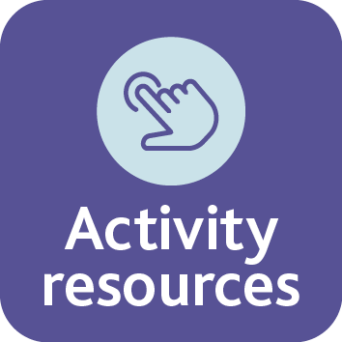
Activity: Enabling educational success
How is Check & Connect: Te Hononga impacting on people’s lives?
What’s enabling these gains?
What are some issues people might face?
What does education success look like for the people you saw in the video?
What are some of the factors that make Check & Connect: Te Hononga work?
Watch: Check & Connect - And it works
Notes:
Activity: This activity is intended to provide a sense of the range of ways Check & Connect: Te Hononga can impact on ākonga outcomes, taking into account the dimensions of Te Whare Tapa Whā. It uses a template, available by clicking on the slide’s ‘Activity resources’ button.
Don’t get too caught up in the template – its purpose is to promote active listening. Move quickly into the opportunity for discussion.
Talk through the dimensions of Te Whare Tapa Whā: taha tinana (physical wellbeing), taha hinengaro (mental and emotional wellbeing), taha wairua (spiritual wellbeing), and taha whānau (social wellbeing).
Hand out copies of the template and pens. Play the video and have people record what they can hear about the outcomes of Check & Connect: Te Hononga in terms of Te Whare Tapa Whā.
Prompt discussion, using the questions on the slide.
For additional information and ideas, you could go to:
How are you? | Te Whāriki Online (tki.org.nz)
Te Whare Tapa Whā ­– the four sides of wellbeing – AKO (akojournal.org.nz)
Wellbeing for success a resource for schools.pdf (ero.govt.nz)

Slide 15
Ngā tūranga o Te Hononga | Check & Connect roles
Everyone involved in the initiative will work towards the same goal of engagement and success for the student. Everyone needs to understand that this partnership is resolutely learning focused.
(Check & Connect: Te Hononga manual, p. 23)
Ākonga, whānau, and iwi
Tumuaki
Principal
Kaiurungi
Coordinator
Kaimahi
Staff
Kaihoe
Mentor
Kaiārahi
Supervisor
Notes:
Explain that the success of Check & Connect: Te Hononga depends upon the creation of a system in which people who hold different roles work together to make school a place where rangatahi feel they belong, are valued, and want to participate.
Emphasise: For all of us, our children hold our past and our future. Partnership with whānau is critical to making Check & Connect: Te Hononga work.
Refer participants to pages 14–25 of the manual, which will give them a sense of the different people likely to be involved, and how. Then present this brief overview of the roles. [Note that the roles of kaiurungi and kaihoe are covered in more depth in the next two slides.]
Ākonga and their whānau are at the heart of Check & Connect: Te Hononga; kaihoe | mentors build relationships and share progress with whānau
Tumuaki | Principal: responsible for information sharing, advocacy, resourcing, relationship-building
Kaiurungi | Coordinator: oversees implementation and administration and strives to maintain its fidelity
Kaihoe | Mentor: the key role in the initiative; works collaboratively, for at least two years, with the ākonga, their whānau, and their kaiako to implement strategies that support school engagement and educational success
Kaiārahi | Supervisor: provides ongoing support and guidance for kaihoe
Kaimahi | School staff: share information and ideas; support the kaihoe in their work, including through their willingness to try new, different approaches that might support a student’s engagement and sense of belonging.
Explain that there are also other supports. These vary but may include your regional Ministry office, Learning Support Coordinators, Resources Teachers: Learning and Behaviour, and Oranga Tamariki through Youth Workers in Secondary Schools (YWiSS).

Slide 16
Kaiurungi | Coordinator role
Notes:
Reinforce the fact that the primary task of the kaiurungi (coordinator) is to oversee the implementation and administration of the initiative and strive to maintain its fidelity.
Go through the key aspects of the role shown in the table, one by one.
Explain that the role of the kaiurungi (coordinator) will be covered in much more depth in a subsequent session just for kaiurungi.

Slide 17
Kaihoe | Mentor role
Watch: Check & Connect - Continuity of support
Notes:
Reinforce the fact that the primary task of the kaihoe is to work collaboratively, for at least two years, with the ākonga, their whānau, and their kaiako to implement strategies that support school engagement and educational success.
Explain that participants are now going to watch a video and then do an activity around the role of the mentor.
Watch the video.

Slide 18
Activity: Kaihoe | Mentor role
Working in pairs or small groups, discuss what you learnt from the video.
Then choose two of the following key mentor tasks and briefly discuss what each might involve:
Collaborates
Monitors
Liaises
Ensures alignment
Problem solves
Records
Notes:
You may wish to assign two key mentor tasks to each pair or group, or just let them choose their own two.
After 5 minutes, ask each pair or group to report back briefly. Below are some examples of possible responses that you may wish to contribute during reporting back.
Collaborates: Works collaboratively, for at least two years, with the ākonga, their whānau, and their kaiako to implement strategies that support school engagement and educational success
Monitors: Tracks data for ākonga attendance, lateness, and achievement
Liaises: Liaises between home and school to build connections for the ākonga
Ensures alignment: Ensures alignment with what other adults working with the ākonga are doing (e.g., the pastoral care team, a social worker, sports coaches, or kapa haka tutor)
Problem solves: Identifies barriers to success for the ākonga, and problem solves with them to identify activities and ideas to help them overcome these barriers
Records: Maintains written records (attendance, meetings with the ākonga, kaiako, whānau) and provides data on their ākonga to the Check & Connect: Te Hononga kaiurungi (coordinator)

Slide 19
Training overview
There will be:
One more session for kaiurungi (coordinators)
Two more sessions for kaihoe (mentors)
Ongoing support for kaihoe from their kaiārahi (supervisors).
Your manual is your main information source of information, and there is additional support material (e.g., videos) on the PB4L website at Check & Connect: Te Hononga.
Notes:
Reassure
Having learned more about what their roles will involve, kaiurungi and kaihoe may be feeling a little intimidated. However, there is more training to come.
Explain
There will be one more session for the kaiurungi and two more for the kaihoe. However, kaiurungi are very welcome to come to the kaihoe sessions if they wish. [Presenter – you may wish to change this paragraph and the slide to reflect your regional implementation model and training for Check & Connect: Te Hononga.]
Mentors also have ongoing support from kaiārahi (supervisors). These people generally come from outside of the school. They have specialist skills that mean they can help kaihoe identify issues of concern and suggest ideas for supporting the ākonga. They can also address safety concerns and refer ākonga to other services (e.g., mental health or drug and alcohol services). Kaiārahi should meet with kaihoe for a minimum of one hour every three weeks.
The manual is a your ‘go to’ source of information. While kaihoe need to get to know the major section on ‘Guidance for mentors’ very well, kaiurungi also need to be familiar with it so they can provide appropriate support.
Note: There is additional material (including the activity templates and the videos watched during training) on the PB4L website: https://pb4l.tki.org.nz/Check-Connect

Slide 20
Purpose of this session
The purpose of this session was for you to learn about:
why it is important to address ākonga attendance and engagement
the origins and development of Check & Connect: Te Hononga
how Check & Connect: Te Hononga works, and what makes it distinctive
who is involved and what their roles and responsibilities are.
Have we achieved our purpose for today? Do you have any questions?
Notes:
Review the purpose and how well the group feels they’ve achieved it.
Ask participants if they have any further questions, concerns, or ideas. Record these for follow-up. Let people know that they can talk to you personally. You want people to walk away with an honest sense of the commitment they are making, balanced by a sense of optimism and of reassurance that they will be supported to play their part.
Check that participants know when and where they will next be gathering, and with whom.
Encourage participants to read pages 5–12 of the Manual before the next session. Suggest that people may like to do this together, especially if they will be working together.

Slide 21
Check & Connect: Te Hononga
Section 2
The role of the kaiurungi
Notes:
This is a targeted session for kaiurungi (coordinators). In full, it lasts for approximately 3 hours. If time is tight, you may wish to split it into two sessions or drop some activities.
Welcome attendees to the session. Thank them for coming and, once again, acknowledge their caring and commitment in taking on roles within this important initiative. Explain that the last session was intended as an introduction to Check & Connect: Te Hononga. This time, they will be delving more deeply into the role of kaiurungi and looking at the information and support provided in the manual.
See slide 1 for notes on setting the tone for the session and ensuring the comfort of participants.

Slide 22
Purpose of this session
The purpose of this session is for you to learn about:
your role and responsibilities as kaiurungi (coordinator)
the typical steps involved in implementing Check & Connect: Te Hononga
the risks and possible indicators of disengagement
how to support kaihoe (mentors)
monitoring and evaluation of Check & Connect: Te Hononga.
Notes:
Talk through the purpose.

Slide 23
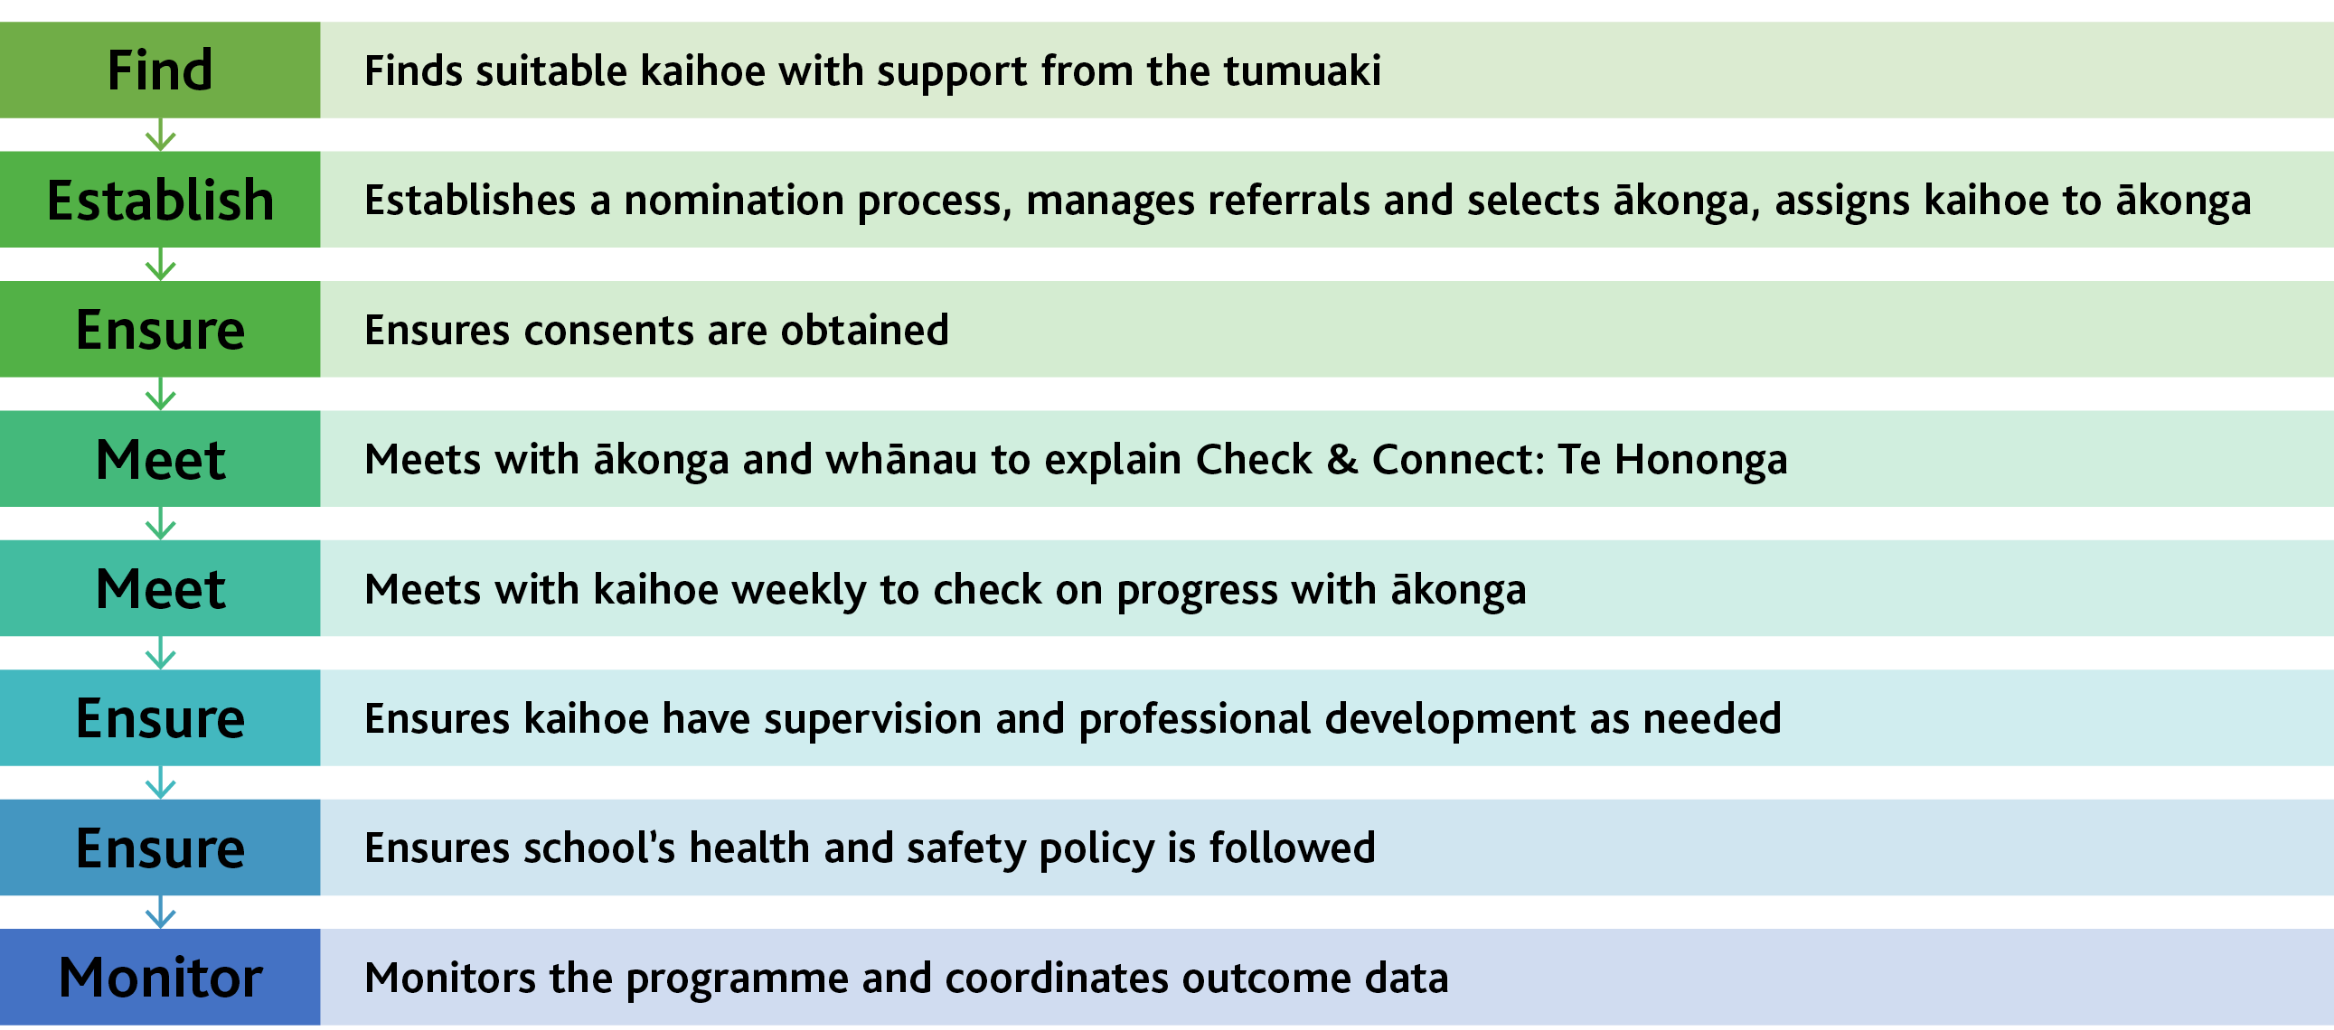
Overview of the kaiurungi (coordinator) role
Notes:
Explain that the diagram on this slide is the top-level summary of the kaiurunga role discussed in the previous session. In this session, they will take a closer look at the tasks and responsibilities associated with the role of kaiurungi and how these contribute to implementation.
Reinforce the fact that the primary task of the kaiurungi is to oversee the implementation and administration of the initiative and to maintain its fidelity. This is an important role with a lot of responsibility. It’s important to remember it will be supported by the tumuaki, deans, heads of department, other members of the senior leadership team, and staff from the MOE regional office.
Explain that there is also flexibility in how the kaiurungi fulfils their role. At times, they will adapt it to better fit their local context, while remaining mindful of the importance of fidelity to the key aspects and practices of Check & Connect: Te Hononga. For example, if there is already a kaihoe established in the school, kaiurungi may wish to involve them in the nomiation process and in the initial meetings with ākonga and whānau..

Slide 24
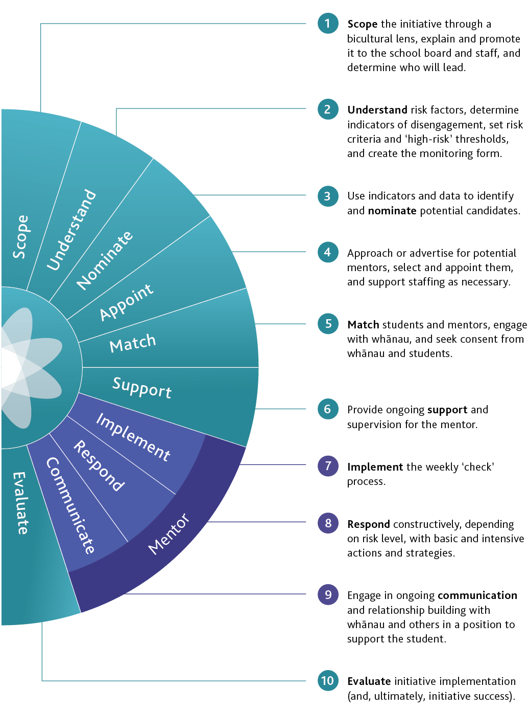
Implementation overview
Key steps in the implementation of Check & Connect: Te Hononga
Notes:
Direct the participants to the implementation overview on page 13 and ask them to read it through.
Repeat the message that the manual unpacks these steps in detail, so it is important to become very familiar with it.

Slide 25
Activity: Kaiurungi areas of responsibility and tasks
Areas of responsibility and related tasks?
Notes:
Before the presentation, you will need to have prepared cards and tables, available by clicking on the slide’s ‘Activity resources’ button.
You will need:
several sets of cards, cut out from A3 printouts of the master PDF; the number of sets will depend on how many kaiurungi are taking part in training – aim for about one set per three kaiurungi
the same number of A3 printouts of the table on which pairs or groups place the cards
photocopies of the completed table [the ‘answers’], one per kaiurungi.
Divide kaiurungi into pairs or small groups for the activity.
Ask the kaiurungi to read pages 15–16 of the manual to get a sense of the sorts of tasks that they will perform as kaiurungi.
Give each group a set of the cards and a printout of the table that matches key tasks and responsibilities with the steps in implementation. Ask them to note the instructions at the top of the table and to match the cards up with the key implementation steps.
When complete, give the kaiurungi the handout of the completed table.
Explain that the list of tasks is not exhaustive and ask them to share any others they think may be necessary.

Slide 26
Activity: Requisite knowledge, skills, and qualities
Coordinators require a good understanding of the aims and structures of Check & Connect, so they can fully support mentors and ensure that the initiative is implemented with fidelity. They ensure that mentors are:
building positive, [mana-sustaining] relationships with students and whānau
checking on student progress by systematically monitoring data and ‘alterable risk factors’ (see page 27, Predictors of dropout)
connecting with the student through personalised timely responses, problem solving, and skills building.
(Check & Connect: Te Hononga manual, p. 16)
Notes:
Before the presentation, you will need to have photocopied the activity template that accompanies this slide onto A3, copying enough copies for participants to work in pairs on the activity. (Click on the slide’s ‘Activity resources’ button to access the template.)
Ask participants to work in pairs to identify the sorts of skills and qualities kaiurungi will require to fulfil their role. Assign one or two rows of the template to each pair and have pairs briefly feed back to the larger group after 5 minutes discussion.
If necessary, reassure participants that they have these skills in abundance and that the manual has information and tools to help. Stress the importance of their reading the entire manual later, in their own time.
Note: The manual uses the term “mana-enhancing”. The change in the slide reflects the understanding that in fact, mana is something a person is born with and that it does not need to be improved.

Slide 27
Staff and community engagement
Success requires broad support from across the school and its community, from:
staff
whānau
community groups
contributing schools.
See the manual, pages 22–25.
Notes:
Explain that the manual discusses the importance of:
gaining staff buy-in and support
building relationships with whānau
working with community groups
liaising with contributing schools.
Ask the kaiurungi to read the description of the tumuaki (principal) role on page 14.
Emphasise that while kaiurungi have a significant role to play in ensuring Check & Connect: Te Hononga is implemented as intended, the initiative relies on everybody working together. In particular, the work on gaining support for the initiative is shared with the whole senior leadership team, and especially with the tumuaki.

Slide 28
Gaining staff buy-in and support
School leadership is crucial to the success of Check & Connect. The principal and the senior management team need to understand the transformative aims of Check & Connect and champion its implementation. It’s also important that staff understand and support the life-changing potential of the student–mentor relationship.
(Check & Connect: Te Hononga manual, p. 22)
It is important that staff:
understand and support the intent of Check & Connect: Te Hononga
understand why kaihoe (mentors) need access to student data and help them to source the information they need
are available to discuss progress and data with kaihoe when required
recognise that the kaihoe is not a ‘magic wand’ or ‘fix-it’ for the ākonga.
Notes:
Reinforce the fact that this is a team effort. Everybody needs to work together to make the difference for the ākonga being mentored. Kaiako spend a great deal more time with ākonga than kaihoe and continue to hold primary responsibility for their engagement in learning. Both the kaiako and kaihoe hold important knowledge about ākonga – sharing information and data ensures that all that knowledge is brought to bear to improve ākonga learning and wellbeing.
Suggest the following actions but note again that responsibility for these actions is shared with the tumuaki and senior management team and does not rest solely with the kaiurungi:
Organise for Check & Connect: Te Hononga to be presented to staff. [There is a separate set of PowerPoints designed specifically for this. It takes about 15 minutes in all, including showing one of the Check & Connect videos.]
Determine how regularly the board of trustees wishes to be updated.
[If participants are from PB4L-SW schools ...] Meet with the PB4L–SW team to ensure alignment with other initiatives in the school.
Ask participants to look at the two sets of bullets on the top half of page 18 of the manual. These can be helpful if it becomes necessary to clarify with staff what is and what is not part of the kaihoe role.

Slide 29
Activity: The risks associated with disengagement
What are some of the risks of disengagement?
Can you provide an example or story to illustrate each risk you identify?
How was the risk addressed so that there were positive outcomes for the ākonga?
Notes:
Remind kaiurungi of the messages in the initial session on Check & Connect: Te Hononga that disengagement and non-attendance are significant and worrying issues. They impact on ākonga attainment and wellbeing in ways that can have lifelong negative impacts on them, their whānau, and their communities. Remind them of the positive outcomes of Check & Connect: Te Hononga and that this long-term approach to mentoring has a strong record of success.
As a whole group, brainstorm possible risks associated with disengagement. You may wish to encourage participants to provide brief examples or stories that illustrate the risks they identify – to avoid this becoming deficit-focused, encourage participants to share ‘good news’ stories in which risks were addressed and there were positive outcomes for ākonga.
Here is a list of possible risks. You may wish to prompt consideration of these risks during the brainstorm.
Risks from disengagement include:
ākonga joining networks outside of school that could be detrimental to their long-term wellbeing
a reduction in the informal controls on behaviour that come through school attendance
social exclusion from positive peer groups
changes in how identity develops, which can change how ākonga feel about themselves
academic failure
elevated risk of anxiety or depressive symptoms
greater risk of low income and unemployment later in life.

Slide 30
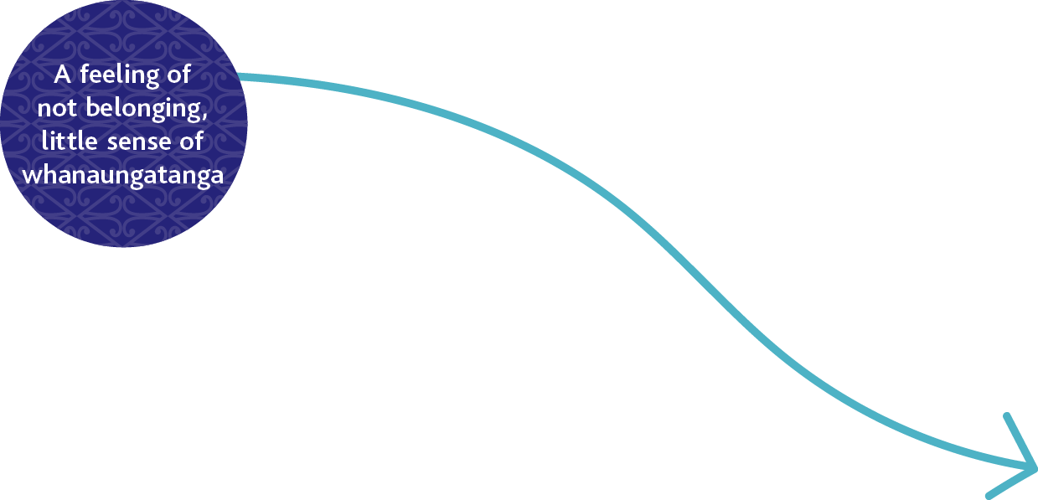
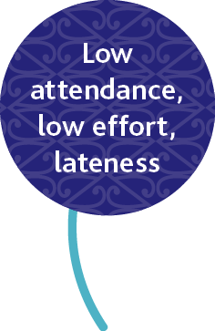
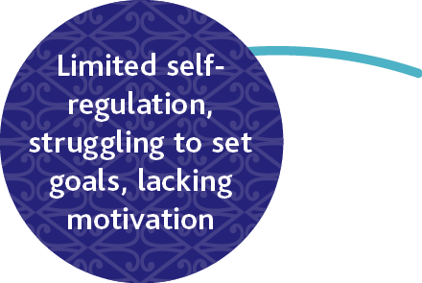
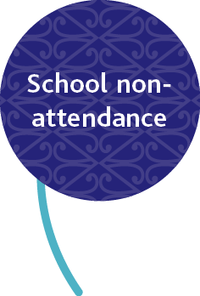
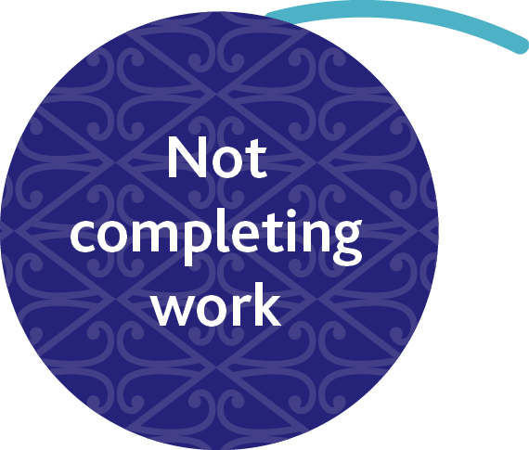
The process of disengagement
Notes:
Explain
Disengagement operates on a continuum. Anyone can feel disengaged for a brief period, under particular circumstances. But when ākonga feels disengaged over a long period of time, they are at risk of behaviours that put themselves and others at risk of harm.
Disengagement is something that goes on in a person’s mind and that unfolds over time. It’s not generally seen as an acute event and may not be observable. However, the way someone behaves can offer indications of what is happening. These indicators may look different in different contexts, so schools need to identify and list indicators of disengagement for ākonga in their context.
Reinforce the fact that disengagement is a process that process that happens over time. This means that there is time to act – if we know what to look for, we can intervene before things go too far.
[See the manual, pp. 26–34]

Slide 31
Activity: Indicators of disengagement
TYPE
DEFINITION
Behavioural
Lateness, missed classes, truancy, referrals to dean, minimal co-curricular participation
Lack of academic progress, failure to complete class tasks and projects
Academic
Unwillingness to engage in individual learning, low academic self-efficacy and perceived competence
Cognitive
Apparent lack of personal goals, social isolation, feelings of not belonging.
Affective
(Check & Connect: Te Hononga manual, p. 27)
Notes:
Remind kaiurungi that Check & Connect: Te Hononga is a finite resource, and it is not right for all ākonga. It’s very important not to:
overburden kaihoe with more ākonga than they can cope with
nominate ākonga who need different or more intensive support.
For this reason, every school needs to create a list of indicators of disengagement to guide their nomination of ākonga for the initiative.
Explain: The manual recommends that schools identify and categorise indicators of engagement to get a sense of what ākonga are experiencing and the kinds of support they need. There are different ways of doing this; this one on the screen is an example from the manual (p. 27).
Point out that behavioural and academic indicators are relatively easy to observe and measure, but that cognitive and affective disengagement are internal; people often keep their thoughts and feelings to themselves. An ākonga might think but not say that they don’t believe they need school to be a social media influencer or play professional sport. They might feel but not say that they don’t belong or are misunderstood.
Place a large sheet of paper [preferably A1] on the wall with the table from the linked resource reproduced on it. (Click on the slide’s ‘Activity resources’ button for this).
Give kaiurungi sticky notes and ask them to quickly add notes to the table’s cells to show indicators of disengagement before mentoring begins, and what they would like to see after twelve months of mentoring.
After five minutes, ask participants to sit down, and read out some of the indicators on the sticky notes.
[See the manual, pp. 26–34 and 60–62.]

Slide 32
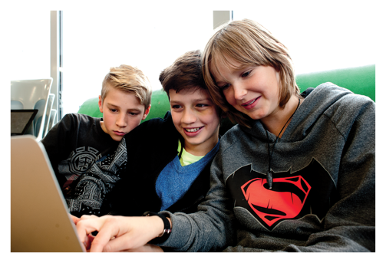
Activity: Predictors of non-attendance
Check & Connect aims to reduce the number of alterable risk factors, and their seriousness, and to enhance what are known as ‘protective factors’.
(Check & Connect: Te Hononga manual, p. 28)
Risk factors predictive of non-attendance may be:
unalterable ‘status factors’ (e.g., age, disability)
alterable factors (e.g., attendance, behaviour).
These may be countered by protective factors (e.g., a caring relationship, a skill or interest).
Notes:
For the activity, you will need photocopies of Appendix 1 [page 79] in the manual.
Tell the kaiurungi that to predict the probability of non-attendance, they need to be able to distinguish between three sets of factors and have some idea of the relationship between them. These are:
status factors, like age and disability, that cannot be altered
alterable factors, like attendance and behaviour, that we can influence
protective factors, like positive relationships or a skill or interest that motivates ākonga.
Stress the fact that Check & Connect: Te Hononga builds on innate strengths and opportunities for helping ākonga find a pathway towards a brighter future. That means the focus needs to be firmly on:
influencing the alterable factors in positive ways
building upon and strengthening the protective factors.
Ask the kaiurungi to read pages 27–29 of the manual. Then ask them to work in small groups, to select an ākonga from one of their schools [changing their name to ensure anonymity], and to use the Risk Inventory (Appendix 1) to complete Planning Activity 1 on page 29. (It doesn’t matter that people are likely to come from different schools – sharing ideas and experiences across schools can be very productive.) Note that many of the risk factors in Appendix 1 are ‘status factors’. Prompt them to consider others that are alterable.
End by briefly talking through Planning Activity 2 on page 29, reinforcing the value of kaiurungi completing it when they are back in their schools.

Slide 33
Nominating and referring ākonga
Kaiurungi need to establish:
criteria to guide their school’s identification and nomination process
guidelines for deciding who are most likely to benefit from a kaihoe.
Interactive PDFs for Check & Connect: Te Hononga
Notes:
Explain that while the Risk Inventory (Appendix 1) allows you to identify ākonga at risk of disengagement, you still need to establish a set of criteria to guide your identification and nomination process and set up guidelines for deciding who, of the ākonga who meet your criteria, are most likely to benefit from a kaihoe.
Ask someone to read aloud the excerpt from a school trial report on page 31 of the manual and, as a whole group, briefly discuss whether the ‘three-test’ system set up in this school seems fair and workable.
Remind kaiurungi that their tasks include “manage referral procedures and the selection of ākonga” and “select, adapt, or develop nomination procedures and forms”.
Point out that the manual includes forms schools can use to identify and nominate ākonga. As well as the Risk Inventory (Appendix 1), there is support for gathering information (Appendix 2), an example of a nomination form (Appendix 3), and Reflective questions from Te Huia (Appendix 9). Appendices 1 and 3 are also available as interactive PDFs on the PB4L website, which allows schools to create, amend, and store e-copies.
If necessary, show kaiurungi where they can find the interactive PDFs online, using the hyperlink in the slide.

Slide 34
The weekly ‘check-in’
The weekly monitoring form (which may be hard or soft copy) is a key component of Check & Connect. It is the subject of each weekly ‘check’ meeting, the means by which the student and mentor keep focused on the student’s educational and learning goals, and a means of measuring and celebrating progress. It allows mentors to record the ‘connect’ actions and strategies they have employed – both ‘basic’ and ‘intensive’ – in response to what the ‘checking’ process reveals.
(Check & Connect: Te Hononga manual, p. 31)
Notes:
Remind the kaiurungi that key tasks for kaihoe are to:
implement a weekly ‘check’ process
respond constructively, depending on risk level, with basic and intensive actions and strategies.
Ask kaiurungi to read pages 31–32 of the manual.
Clarify that, as part of the weekly ‘check’, kaihoe monitor how ākonga are doing in relationship to a set of alterable risk indicators that they, as kaiurungi, have determined for each ākonga. Kaihoe then determine the most constructive ways to connect with the ākonga, responding with more intensive responses when required.
Refer the kaiurungi to the monitoring form examples in Appendix 4 (pp. 87–90) to see how they enable close monitoring of ākonga responses and for a record to be kept of progress and meetings. As well as the weekly monitoring form, there are forms for recording monthly summaries of case notes and meetings with teachers and whānau.
Encourage the ākonga to use the Ministry-supplied forms, rather than design their own. This will ensure that all relevant information is collected and can be used to provide evidence of effective practice. The information is used for this purpose at the regional level, as well as by the school.

Slide 35
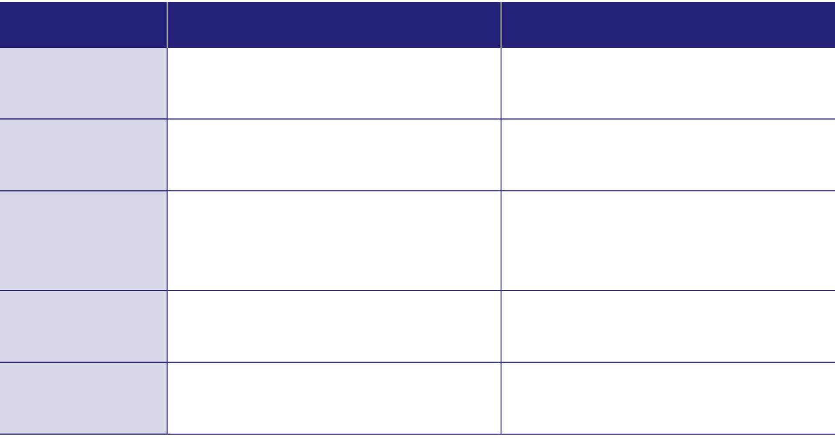
Setting risk thresholds
Indicators and thresholds:
need to be workable
will look different across different schools
should set high but realistic expectations.
RISK INDICATOR
DEFINITION
HIGH-RISK THRESHOLD
Lateness
Arriving late for school or class
Five or more incidents per month
Missing classes
Missing selected class periods within a day without an excused reason
Three or more incidents per month
Absenteeism (truancy)
Full day’s absence with or without an excuse. Days out when suspended are also included. Mark the student as absent if most of the classes in a day are missed.
Three or more incidents per month
Inappropriate behaviour
Being sent to office or senior staff for inappropriate behaviour
Three or more incidents per month, in combination with other concerns
Low achievement
Not engaging at the appropriate curriculum level
More than one year level below expected achievement levels in two or more classes
(Check & Connect: Te Hononga manual, p. 33)
Notes:
Refer the kaiurungi to page 33 of the manual.
Discuss the importance of setting high but realistic expectations. Suggest that kaiurungi consider the ‘Goldilocks principle’ – setting expectations that are not so high that an ākonga experiences regular failure, and not so low that risks are not addressed. They need to be just right.
Remind the kaiurungi that the major section ‘Hei ārahi i ngā kaihoe | Guidance for mentors’ in the manual (pages 40–73) has more detail and support on many of the topics discussed today. Refer them to Tables 7–9 (pages 58–62) to get a sense of appropriate ‘basic’ responses vs. more intensive responses for ākonga who have passed a ‘high-risk’ threshold.

Slide 36
Activity: Selecting, appointing, and supporting kaihoe
Relevant tasks include:
Select kaihoe, in consultation with the principal
Develop job descriptions and employment agreements
Source (and possibly provide) training for kaihoe
Appoint a kaiārahi (supervisor) for the kaihoe and establish a support network
Meet with kaihoe regularly to provide support
Ensure kaihoe have training in relation to safety (e.g., during home visits)
Ensure kaihoe adhere to the school’s health and safety policy
Match ākonga and kaihoe
Develop risk indicators for moving from basic to intensive mentoring.
Notes:
Remind the kaiurungi that this list of tasks involved in selecting, appointing, and supporting kaihoe is on an A3 handout from an earlier activity.
Clarify that the process of selecting and appointing a kaihoe needs to be done in line with the school’s usual processes.
Ask the kaiurungi to work in pairs to read pages 35–36 of the manual and to discuss their understanding of who can be a mentor and the characteristics this requires.
Stress the importance of reading the major sections in the manual Te kōwhiri me te whakatū i ngā kaihoe | Selecting and appointing mentors (pages 35–39) and Hei ārahi i ngā kaihoe | Guidance for mentors (pages 40–73). If the initiative is to be successful, you need to have selected the right people for the role and to have provided them with the support they need to succeed.
Point out that the appendices contain forms schools can use to support you to select and appoint mentors – examples of a mentor job description (Appendix 6) and a mentor letter of agreement (Appendix 7).

Slide 37
Activity: Working with kaihoe | mentors
For everyone’s safety and wellbeing it is important that kaihoe:
are inducted into the school and helped to become familiar with its staff, systems, and practices, including its student management system (SMS)
know and understand the school’s health and safety policies and procedures
receive cultural supervision and guidance, when necessary
receive support and guidance from a kaiārahi (supervisor).
Watch: Check & Connect - Working together
Notes:
Play the video.
Lead discussion about what the video suggested to the kaiurungi it about their role in ensuring that everyone who takes part in the initiative feels safe, protected, and valued, and that it works as efficiently and effectively as possible. Reinforce the importance of ensuring kaihoe are familiar with and understand the school’s health and safety procedures, and that they have access to a kaiārahi (supervisor).

Slide 38
Obtaining ākonga and whānau consent
Remember:
When approaching whānau, the aim is to work together as partners to support the ākonga.
The approach for whānau should be individualised and build upon the current relationship between whānau and school.
After the initial approach and obtaining consent, the kaihoe becomes the key contact person for whānau.
Written consent can be difficult to obtain. Evidence of verbal consent can be sufficient.
Notes:
Remind the kaiurungi that their tasks include:
Meet with each ākonga and their whānau to talk about the initiative
Select, adapt, or develop consent procedures and forms
Ensure that ongoing consents for ākonga and whānau are understood and obtained
Facilitate the initial meeting between kaihoe and whānau.
Recommend that the person with the best relationship with whānau should make the initial contact and then connect everyone.
Explain that:
they will need to develop and record a set of protocols to be followed when connecting with whānau, gaining consent, and bringing an ākonga into the intervention
these protocols should embed creative, culturally appropriate ways to connect with whānau that are individualised to the ākonga and their whānau
the protocols need to include informed consent, preferably written, but they need to be sufficiently adaptable for situations where it is only possible to get verbal consent.
Talk through the example of a whānau and student consent form on page 91 of the manual.

Slide 39
Activity: Working with whānau
How open and trusting are our school’s current relationships with whānau whose tamaiti need additional support? To what extent are they mana-enhancing?
What strategies might we use to support kaihoe in their liaison with whānau (e.g., around initial introductions, information-sharing, or cultural competence)?
Which of these strategies could we immediately action, and which might first require input from senior leadership?
Watch: Check & Connect - Working with families
Notes:
Remind the kaiurungi that their tasks also include:
Establish protocols and processes for building relationships with whānau
Liaise with whānau, in mana-enhancing ways, so they feel respected and valued as partners in their children’s education.
Remind the kaiurungi that the manual provides support for this. Ask them to read the following sections:
‘Building relationships with whānau’ (page 23)
‘Building trust’ (pages 65–66)
‘Communication’ (pages 67–68).
Play the video.
Ask the kaiurungi, working in small groups, to draw on their experience and what they’ve just read and seen in the video to discuss the three questions on the slide.
Depending on available time, ask the groups to report back briefly after 7 minutes.

Slide 40
Te aroturuki me te arotake | Monitoring and evaluation
Monitoring and evaluation play a key role in understanding the impact of Check & Connect for individual students and in determining how well the initiative is being implemented.
Three key aspects of monitoring and evaluation for Check & Connect are:
monitoring its impact for individual students
assessing fidelity of implementation
evaluating the initiative.
(Check & Connect: Te Hononga manual, p. 74)
Notes:
Draw attention to the section of the manual on monitoring and evaluation [pages 74–77].
Ask kaiurungi what they make of the three key aspects of monitoring and evaluation on the slide, and why they think they are important. The first and third may seem obvious, on the basis of prior experience, but the second may be less familiar.

Slide 41
Monitoring the impact for individuals
Dee
Dee started Check & Connect in year 10. She had low self-esteem and was experiencing grief from losing a significant adult in her whānau. Her parents were separated, and she had no siblings.
In year 11, Dee’s attendance rate improved significantly to 75%, and teachers commented on her confidence in class and great attendance. In November, she passed NCEA level 1 prior to external exams.
In year 12, Dee is working to complete NCEA Level 2. She has lost another significant adult in her life, and grieving is making it difficult for her to attend school. However, she has been able to re-engage with school and reset her goals to improve attendance and gain 40 level 2 credits by the end of term 3.
Notes:
Invite kaiurungi to read the vignette and notice how data collection allows the people supporting Dee to monitor how she is doing and the impact of the initiative.
Reinforce how important it is to:
determine whether the initiative is working for the ākonga involved
collect and analyse data about a student’s performance before, during, and after the initiative.
Remind the kauirangi that their tasks include:
provide kaihoe with access to the school’s student management system (SMS) and training in its use
meet with kaihoe regularly to check on progress and provide support
coordinate the collection of outcome data (monthly).
Tell the kauirangi that they will need to determine what data to collect, when, and how it will be reported, aiming for a system that is simple, consistent, and thorough.
Explain that the data collection tools to support kaiurungi and kaihoe to work together on monitoring and evaluation include:
the monitoring form (Appendix 4) that they have already looked at
the form for monitoring the impact of Check & Connect: Te Hononga (Appendix 10)
case notes for individual ākonga.

Slide 42
Assessing fidelity of implementation
‘Fidelity of implementation’ refers to how closely implementation adheres to the intentions of an initiative. If an evidence-based initiative is not implemented as intended, the outcomes are likely to be disappointing.
(Check & Connect: Te Hononga manual, p. 75)
Notes:
Refer the kaiurungi to the explanation of the term ‘fidelity of implementation’ and discuss what can happen if they and their colleagues do not adhere to its fundamental principles and processes.
Ask kaiurungi to look at the self-assessment framework on page 76 of the manual.
Explain that:
their school can use or adapt this framework to record their progress in implementing Check & Connect: Te Hononga
like the other tools, it is available as an interactive PDF online at https://pb4l.tki.org.nz/
they will need to decide how often they will use the tool to assess fidelity, and how they will document and report on progress (e.g., once per term).

Slide 43
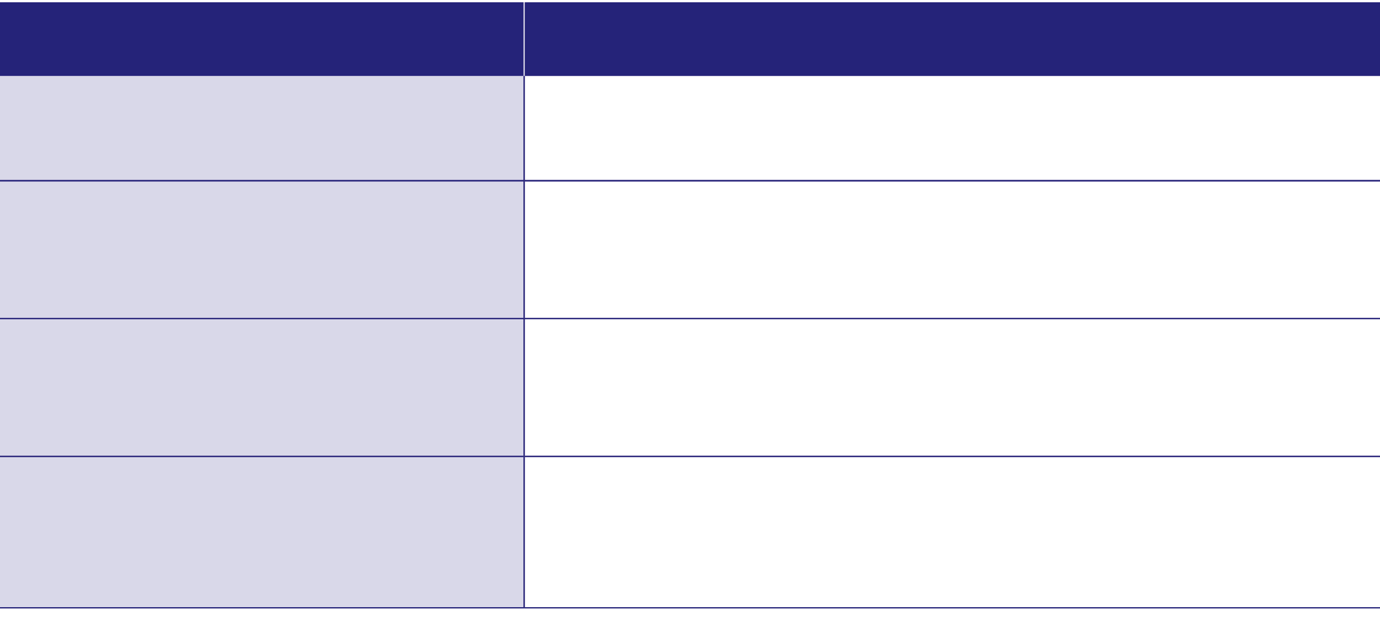
Evaluating the initiative
QUESTION
TO ANSWER THE QUESTION
To what extent are Check & Connect students more likely to stay in school?
Consider enrolment and retention rates, mobility, attendance, lateness, frequency of missed classes, stand-downs, and suspensions.
To what extent are Check & Connect students more likely to make progress in school?
Consider academic attainment, assignment completion, NCEA credits gained, and behaviour referrals.
To what extent are Check & Connect students more likely to complete their secondary schooling?
Calculate the number of years Check & Connect students are spending at school on average (e.g., three, four, or five years).
To what extent are Check & Connect students re-engaging with school and learning?
Collect data on teacher and student perceptions of student engagement using a locally developed or other survey.
Track Check & Connect students’ participation in school-wide activities.
(Check & Connect: Te Hononga manual, p. 77)
Notes:
Refer kaiurungi to page 77, which again reinforces the importance of being systematic about your approach to data collection from the start, so that you have the information you need to answer your evaluation questions.
Explain that:
they will need to know what their questions are – the table from page 77 on the slide suggests some examples and where the information might be found
they should also consider collecting and using stories, interviews, and surveys from participants
as with checking on fidelity of implementation, they will need to decide on how they will document and report on progress.

Slide 44
Purpose of this session
The purpose of this session was for you to learn about:
your role and responsibilities as kaiurungi (coordinator)
the typical steps involved in implementing Check & Connect: Te Hononga
the risks and possible indicators of disengagement
how to support kaihoe (mentors)
monitoring and evaluation of Check & Connect: Te Hononga.
Have we achieved our purpose for today? Do you have any questions?
Notes:
Review the bullets in the slide.
Ask participants if they have any further questions, concerns, or ideas. Record these for follow up and discuss how they can make contact, if necessary. Again, you want people to finish with an honest sense of the commitment they are making, balanced by a sense of optimism and of reassurance that they will be supported to play their part.
Encourage participants to read the manual and suggest that some people may like to do this together, so that they can talk it through. Let them know that they are welcome to come to any of the sessions you have planned for kaihoe.

Slide 45
Check & Connect: Te Hononga
Section 3
The role of the kaihoe
Session 1
Notes:
This is the first of two targeted sessions for kaihoe (mentors). In full, it lasts for approximately two hours. You may wish to add or drop some activities, take in parts of session two, or even merge the two kaihoe sessions to take place over a day.
Welcome attendees to the session. Thank them for coming and once again, acknowledge their caring and commitment in taking on roles within this important initiative. Explain that the last session was intended as an introduction to Check & Connect: Te Hononga. This time, they will be delving more deeply into the role of kaihoe and looking at the information and support provided in the manual.
See slide 1 for notes on setting the tone for the session and ensuring the comfort of participants.

Slide 46
Reviewing prior learning
Check & Connect: Te Hononga
is for ākonga who are at risk of disengaging from learning or non-attendance
involves checking ākonga data and connecting with ākonga to plan responses
was developed in the United States and is successfully implemented in many countries
has been adapted to Aotearoa New Zealand and gives effect to the Treaty of Waitangi
works best with a two-year commitment from a kaihoe (mentor)
involves meeting weekly with ākonga to set goals for improved learning and wellbeing
involves collaboration across a team of people, with ākonga and their whānau at the heart.
Notes:
Review prior learning about Check & Connect: Te Hononga. Check people’s response and be prepared, if necessary, to use relevant slides from the introductory session to refresh their memories.

Slide 47
Purpose of this session
The purpose of this session is for you to learn about:
whakawhanaungatanga – building connections with ākonga – the heart of the matter
your role and responsibilities as kaihoe (mentors)
the skills, knowledge, and attributes your role requires
the risks of disengagement and how it happens
possible indicators of disengagement and the importance of monitoring them
the guidance in the manual.
Notes:
Talk through the purpose.
Remind kaihoe that there will a further session after this where they will learn more about aspects of their role.

Slide 48
Activity: The role of the kaihoe | mentor
Working in pairs or small groups, can you recall the six key mentor tasks that we discussed at our last session? (The first and last are given for you below.)
Collaborates
Monitors
Liaises
Ensures alignment
Problem solves
Records
Notes:
Allow participants 5 minutes for discussion, then seek responses to fill in the missing key tasks in the list.
As you do so, briefly remind them of the information below and reinforce the critical role of the kaihoe (mentor) – that it is the kaihoe who leads the check and connect process but that they do so in collaboration with and supported by a team of people.
Collaborates: Works collaboratively, for at least two years, with the ākonga, their whānau, and their kaiako to implement strategies that support school engagement and educational success
Monitors: Tracks data for ākonga attendance, lateness, and achievement
Liaises: Liaises between home and school to build connections for the ākonga
Ensures alignment: Ensures alignment with what other adults working with the ākonga are doing (e.g., the pastoral care team, a social worker, sports coach, or kapa haka tutor)
Problem solves: Identifies barriers to success for the ākonga, and problem solves with them to identify activities and ideas to help them overcome these barriers
Records: Maintains written records (e.g., on attendance and meetings with the ākonga, kaiako, whānau) and provides data on their ākonga to the Check & Connect: Te Hononga kaiurungi (coordinator).

Slide 49
Persistence plus
Persistence plus
Persistence: The kaihoe helps ākonga see themselves as learners who can succeed.
Continuity: Mentoring is for up to two years and builds on connections with whānau.
Consistency: The kaihoe consistently reinforces the importance of education and learning.
Persistence plus
Persistence:
Continuity:
Consistency:
Notes:
As a group, read aloud the four paragraphs under the heading, “Who can be a mentor?” on page 35 of the manual.
Briefly unpack the three key words, clicking them to reveal more information about each as you do so.
Reinforce the message that the mentor’s role is “less about ‘fixing’ than supporting the ākonga to ‘find a way through’ so they can re-engage with school and learning.” [Manual, p. 35] This requires persistence over an extended period. There will be high and low points requiring your persistence – make sure you reach out for support when you need it.

Slide 50
Key kaihoe (mentor) processes
Key processes to establish:
building trusting relationships with ākonga and whānau
communicating with kaiako
drawing on school and community resources
setting up routines for planning and record keeping, using the forms and documents the school uses for Check & Connect: Te Hononga
accessing data on the school’s management system (SMS).
Notes:
Refer the kaihoe to the major section ‘Guidance for mentors’ on pages 40–73 of the manual. Explain that this is their ‘go-to’ resource and that reading and returning to it regularly will help keep them on track as a kaihoe.
Ask participants to skim read page 41 and read pages 42 & 43 of the manual [the ‘Preparation’ section and Table 4].
Spend a few minutes discussing as a group the ‘First steps’ in Table 4, which summarises the advice on pp. 40–42 re- the importance of:
building trusting, reciprocal relationships with ākonga and whānau
gaining support from the kaiurungi to establish trusting relationships with kaiako
identifying and drawing on school and community resources
setting up routines for planning and record keeping
getting to know the relevant forms and documents
accessing the school’s management system in order to access attendance and other data for discussion (SMS).

Slide 51
Activity: Kaihoe skills, knowledge, and attributes
Watch: Check & Connect - Continuity of support
The mentor role is critical. Mentors are adults who have the knowledge, skills, attitudes, and cultural awareness that will enable them to form strong relationships with their assigned students and whānau, and to work collaboratively with school staff.
(Check & Connect: Te Hononga manual, p. 16)
Notes:
Play the video [this may be one first presented in the joint session.] As the kaihoe view the video, ask them to note down the skills, knowledge, and attributes that they believe they will need to use to fulfil their role. Allow five minutes for them to share their thoughts in small groups. Ask the groups to report back on three or four of the attributes they think would be most important for a new kaihoe to bring to their role.
Tell the kaihoe that they have been appointed because they are known to have these strengths.
Point out the:
list of key personal characteristics (Manual, pp. 35–36)
example of a mentor job description (Manual, pp. 92–93)
bullet points listing what is not part of the mentor’s role (p. 18)
Ask if there anything there that the kaihoe had overlooked or find surprising and talk about why they are there.
Reassure the kaihoe that:
they will be supported to build on their strengths and carry out their mahi by a team of people, and especially by their kaiurungi (coordinator) and kaiārahi (supervisor)
the guidance in the manual includes a section specifically for mentors (pp.40–73).

Slide 52
Implementation of Check & Connect: Te Hononga
Key steps in the implementation of Check & Connect: Te Hononga
Notes:
Refer the kaihoe to the implementation overview on the screen [page 13 of the manual] and point out that their mahi is part of a bigger whole. Briefly talk through the typical steps in implementing Check & Connect: Te Hononga.
Explain that when they look at them closely, they will see that these steps involve different people with different roles connected within a system where a set of routines and processes help these people undertake their tasks. Getting these clear will ensure they can focus on their central task of checking with ākonga and connecting them with appropriate support.

Slide 53
Working with the kaiurungi (coordinator)
Watch: Check & Connect - Working together
Notes:
Play the video, Working together — school and mentor sharing the same understanding.
Ask participants to share with a neighbour the key messages they took from the video.

Slide 54
Support from the kaiurungi (coordinator)
The kaiurungi will:
arrange your employment agreement and provide you with a job description
make sure you have adequate support and guidance from a kaiārahi (supervisor)
match you up with one or more ākonga to mentor
meet regularly with you to support you in your work
ensure you understand how to keep yourself and others safe
ensure you know and understand the school’s policies and procedures around health, safety, consent, and confidentiality.
Notes:
Before the presentation, contact any kaiurungi who will be present and have attended a session tailored to them, and ask them to be ready to talk about their responsibilities for supporting kaihoe.
Talk through each of the bullet points. You may like to clarify that the employment process will be different in different schools, and that it is the school that will be the employer. You might also add that they can expect the relationship with their kairurungi to become increasingly collaborative as you settle into your role and get to know the school and its people.
If a kaiurungi is present, invite them to contribute and to give examples from their experience for some of the bullets.

Slide 55
Support from a kaiārahi (supervisor)
Your kaiārahi (supervisor) will:
help you identify issues of concern and suggest ideas for supporting your ākonga
address safety concerns and help refer ākonga to other services
meet with you for a minimum of one hour every three weeks.
Notes:
As a group, read aloud together the four paragraphs under the heading, “Support from your supervisor” on page 73 of the manual.
Explain that supervision arrangements will vary, depending on kaihoe location and the school they are working in. For example, the situation in the scenario at the base of page 73 is unlikely to be the case for kaihoe in small towns or rural areas.
Discuss any questions that participants have about the kaihoe ­– kaiārahi relationship.

Slide 56
Activity: The risks associated with disengagement
Risks from disengagement include:
ākonga joining networks outside of school that could be detrimental to their long-term wellbeing
a reduction in the informal controls on behaviour that come through school attendance
social exclusion from positive peer groups
changes in how identity develops, which can change how ākonga feel about themselves
academic failure
elevated risk of anxiety or depressive symptoms
greater risk of low income and unemployment later in life.
Notes:
Remind kaihoe of the messages in the initial session on Check & Connect: Te Hononga that engagement and non-attendance are significant and worrying issues. They impact on ākonga attainment and wellbeing in ways that can have lifelong negative impacts on them, their whānau, and their communities. Remind them of the positive outcomes of Check & Connect: Te Hononga and that this long-term approach to mentoring has a strong record of success.
Briefly talk through the risks of disengagement listed on the slide.
Ask kaihoe to move into small groups to share stories that exemplify some of the risks of disengagement, as well as what can happen when these risks are addressed. Emphasise the importance of respecting the privacy of the people involved and so of not sharing names or identifying details. If there’s time, invite the small groups, if they wish, to share an example with the whole group, especially if they have ‘good news’ stories.

Slide 57
The process of disengagement
Notes:
Explain
Disengagement operates on a continuum. Anyone can feel disengaged for a brief period, under particular circumstances. But when ākonga feels disengaged over a long period of time, they are at risk of behaviours that put themselves and others at risk of harm.
Disengagement is something that goes on in a person’s mind and that unfolds over time. It’s not generally seen as an acute event and may not be observable. However, the way someone behaves can offer indications of what is happening. These indicators may look different in different contexts, so schools need to identify and list indicators of disengagement for ākonga in their context.
Reinforce the fact that disengagement is a process that process that happens over time. This means that there is time to act – if we know what to look for, we can intervene before things go too far.
[See the manual, pp. 26–34]

Slide 58
Activity: Indicators of disengagement
TYPE
DEFINITION
Behavioural
Lateness, missed classes, truancy, referrals to dean, minimal co-curricular participation
Lack of academic progress, failure to complete class tasks and projects
Academic
Unwillingness to engage in individual learning, low academic self-efficacy and perceived competence
Cognitive
Apparent lack of personal goals, social isolation, feelings of not belonging.
Affective
(Check & Connect: Te Hononga manual, p. 27)
Notes:
Explain: The manual recommends that schools identify and categorise indicators of disengagement to get a sense of what ākonga are experiencing and the kinds of support they need. Schools, and especially kaiurungi, need to do this to make sure that kaihoe are being assigned to ākonga who are most likely to benefit from their support. Kaiurungi also establish ‘risk indicators’ to help determine when an ākonga may be at increased risk, requiring a more intensive response from kaihoe.
There are different ways of categorising the indicators; this is one that is shown in the manual (p. 27).
Point out that behavioural and academic indicators are relatively easy to observe and measure, but that cognitive and affective disengagement are internal; people often keep their thoughts and feelings to themselves. An ākonga might think but not say that they don’t believe they need school to be a social media influencer or play professional sport. They might feel but not say that they don’t belong or are misunderstood.
[See the manual, pp. 26–34 and 60–62.]

Slide 59
Activity: Identifying types of disengagement
I was great at primary school; the teachers liked me and cared about me. High school is different. The teachers don’t know me.
NCEA and exams and stuff don’t really matter. I don’t care about them. You don’t need them for what I want to do in life.
The friends I hang out with are not at school. I used to play for a school team, but I stopped because I was always home gaming.
I can’t be bothered to do the work in class. When the teacher has a go at me, I get annoyed and disrespectful to get sent out.
I could get NCEA credits but don’t get around to doing the work and handing it in.
Discuss:
What type of disengagement is suggested by each quote?
What might be causing it?
What’s an appropriate response?
Notes:
Before the session, print several copies of the previous slide for kaihoe to use in this activity. You’ll need at least one per group.
Ask the kaihoe to read the slide and move into small groups to discuss:
the type of disengagement each seems to evidence (behavioural, academic, cognitive, affective)
any clues for what might be causing the sense of disengagement
their thoughts about what an appropriate response might be.
Remind kaihoe that while lists of indicators help us notice possible signs of disengagement, they don’t tell us everything about what is happening for an ākonga. For example, they do not tell us about:
the attitudes and expectations of people at home
problems with peer relationships
whether the ākonga is accessing appropriate support at school.
Ask if any of the kaihoe have personal experience of any of these forms of disengagement [e.g., for themselves, whānau members, friends at school], and how it was visible to others.

Slide 60
Activity: Predictors of non-attendance
Check & Connect aims to reduce the number of alterable risk factors, and their seriousness, and to enhance what are known as ‘protective factors’.
(Check & Connect: Te Hononga manual, p. 28)
Risk factors predictive of non-attendance may be:
unalterable ‘status factors’ (e.g., age, disability)
alterable factors (e.g., attendance, behaviour).
These may be countered by protective factors (e.g., a caring relationship, a skill or interest).
Notes:
Tell the kaihoe that to predict the probability of non-attendance, they need to be able to distinguish between three sets of factors and have some idea of the relationship between them. These are:
status factors, like age and disability, that cannot be altered
alterable factors, like attendance and behaviour, that we can influence
protective factors, like positive relationships or a skill or interest that motivates them.
Stress the fact that Check & Connect: Te Hononga builds on innate strengths and the opportunities for helping ākonga find a pathway towards as brighter future. That means the focus needs to be firmly on:
influencing the alterable factors in positive ways
building upon and strengthening the protective factors.
Ask the kaihoe to suggest examples of status, alterable, and predictive factors and list their suggestions under those three headings.
Refer kaihoe to Table 2 (page 28 of the manual) for other examples that they may have missed.

Slide 61
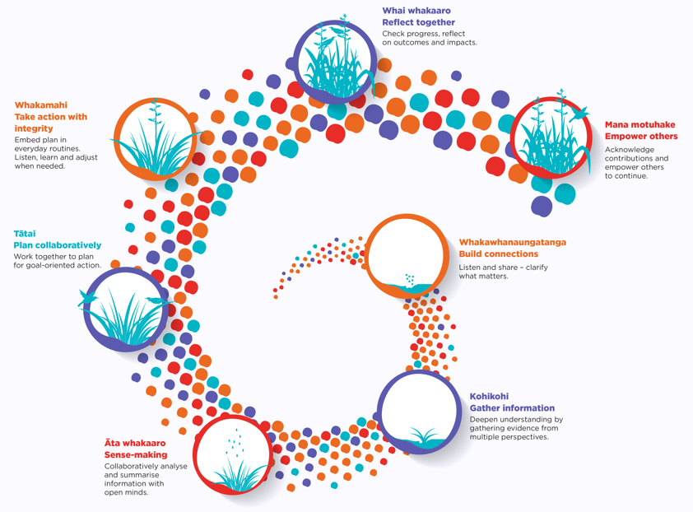
The kaihoe role in practice
Notes:
Explain that He Pikorua is the practice framework used by Learning Support, practitioners, including RTLBs, in the Ministry of Education. It’s fine if they’re not familiar with it; it provides a useful way of digging into aspects of what they will be doing.
Ask kaihoe to quickly skim pages 44–59 to get a sense of what’s covered regarding each of the seven areas of He Pikorua. Assure them that their remaining training will cover the key points, and that they will have opportunities to explore them in greater depth with support from their kaiārahi.
Here is the link to He Pikorua, in case anyone wants to follow up independently: He Pikorua in action – He Pikorua (education.govt.nz)

Slide 62
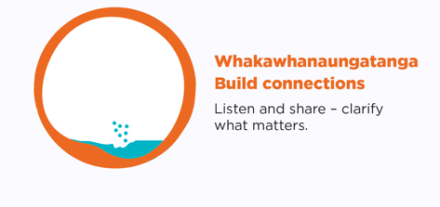
Activity: Whakawhanaungatanga – Building connections with ākonga
What is the purpose of your relationship with ākonga?
What should that relationship look like?
What are some strategies for building trust and influence with ākonga?
What are some specific factors you need to consider when working to build connections with ākonga Māori or ākonga of Pacific descent (e.g., around language, culture, history, and whānau)?
Watch: Check & Connect - Purposeful relationships
Notes:
Explain that the success of the initiative depends upon the two-year commitment kaihoe make to the ākonga with whom they will work. This relationship is what makes Check & Check: Te Hononga distinct – it is at its very heart.
Prepare a large sheet of paper with the questions above and have sticky notes and pens available.
Ask kaihoe to think, pair, and share their response to the questions above. Give them sticky notes to add their responses to the sheet of paper.
Play the video Purposeful relationships.
Ask kaihoe what additions or amendments they might add to their previous ideas.
Point out the advice in the manual [pages 45–46] regarding:
taking time to build relationships that are explicitly focused on engagement, learning, and wellbeing
setting boundaries to ensure safety for themselves and the ākonga
using the suggestions in Appendix 8 (Ngā mahi o te oranga) to discuss and develop activities that are related to four dimensions of wellbeing: Hononga, Hinengaro, Tinana, and Mauri
using the resources suggested in Appendices 2 and 9 to locate reflective questions and statements related to the four domains of wellbeing
understanding the impact of whakamā on Māori and Pacific ākonga
exploring the Tōu Ake Mana Framework developed by Massey University’s Resilience Research Programme for working with vulnerable rangatahi Māori.
Tell the kaihoe that for Check & Connect: Te Hononga to be successful, they also need to establish mutually trusting, collaborative relationships with whānau and to be able to communicate effectively with them. They’ll go into this in the next session, but it’s important to keep it in mind while working through the following slides.
Remind the kaihoe that they have a support system around them. Their kaiurungi is there to help them mediate and foster their relationships with whānau and can help support their awareness of the cultural practices of Māori and Pacific peoples by introducing them to resources such as Tātaiako: Cultural Competencies for Teachers of Māori Learners and Tapasā: Cultural Competencies Framework for Teachers of Paciﬁc Learners.

Slide 63
Health and safety
To ensure safety for yourself and the student, discuss the school’s procedures with your coordinator or the school’s pastoral care team. Check & Connect students are vulnerable young people, and their emotional safety as well as their physical safety must be considered at all times. If you believe that you or the student are at risk of harm, seek support immediately from the school or your supervisor.
(Check & Connect: Te Hononga manual, p. 45)
Notes:
Emphasise the importance of kaihoe abiding by the health and safety procedures of the school. If they are employed by an agency, they also need to follow those set by their employer.
Explain that health and safety practices include:
discussing health and safety with the ākonga, including assuring the ākonga of confidentiality
where possible, being accompanied by another adult whenever making an on offsite visit
raising any concerns about their or ākonga safety immediately with the school kaiurungi [coordinator] or their kaiārahi [supervisor].
Kaihoe can find information and support from:
the manual (pp. 39 and 45)
their kaiurungi, who is responsible for ensuring they have training in relation to safety
their kaiārahi, who can help address safety concerns and refer ākonga to other services (e.g., mental health or drug and alcohol services)
their peer support group.
[See the manual, pp. 39, 45, and 72–73.]
Note: the following three slides enable you to go deeper into the issue of safety, should this be appropriate for the group you are with.

Slide 64
Setting boundaries to ensure safety
Consider:
the values, knowledge, skills, and competencies you bring to this mahi
the importance of setting appropriate boundaries and being clear about your role
the power differential in your relationship with an ākonga
the importance of cultural safety and of developing your own cultural competence
the availability of support and guidance to help you develop further in your role
the potential for relationship breakdowns and importance of seeking help when needed.
Notes:
Explain
The role of kaihoe is demanding. A lot is expected of kaihoe in terms of their professional conduct and the values, competencies, and skills required to be successful. However, the people in the room have been appointed because other people recognise that they already bring much of what is needed.
Kaihoe are there to help ākonga “find a way through’ so they can re-engage with school and learning” (manual, p. 35). They are not there to be a ‘buddy’ or substitute parent.
While all kaihoe want to establish caring relationships with their ākonga, they will not be effective without setting boundaries that maintain an appropriate degree of professional distance.
Kaihoe should be aware that they have the greater power in their relationship with ākonga and be careful not to abuse it.
Some ākonga and whānau, particularly Māori and Pacific people, have had past experiences with education that have undermined trust. It is important for kaihoe to actively grow their cultural competence (e.g., by seeking advice from local kaumātua about ways to work with whānau Māori (mohiotanga)).
The manual contains a great deal of guidance on building safe, healthy professional relationships with ākonga and whānau. Kaihoe will also find support from their kaiurungi, kaiārahi, and peer support group.
Relationship breakdowns or ruptures can happen. If they do, it’s important for the kaihoe to get support from their kaiurungi or kaiārahi as soon as possible.

Slide 65
Information safety, confidentiality, and privacy
Issues and concerns may arise around:
suicide or self-harm
threats of harm to others
threats of harm to you
the disclosure of criminal offences
worrying ākonga behaviours (e.g., heavy substance use)
mentor wellbeing / burnout
conflicts of interest.
Notes:
Explain
While, as a rule, kaihoe will maintain confidentiality, disclosures relating to any of the issues or events listed above cannot be ignored. Kaihoe must urgently take action to inform the school.
Kaihoe must keep a record of all disclosures in their case notes. They should keep in mind that matters that initially seem insignificant may grow in significance later.
Conflicts of interest could include becoming aware that you or another kaihoe is related to or friendly with an ākonga or their whānau.

Slide 66
Protective strategies
Protective strategies include:
support from your kaiurungi (coordinator)
support from your kaiārahi (supervisor)
cultural supervision
peer support
self-care / life balance strategies
professional development
asking for help sooner rather than later.
Notes:
Advise:
Kaihoe should receive supervision regularly; don’t let this fall away.
They should into the habit of reflecting on what has happened with ākonga. Use case notes to document this.
Kaihoe should ask for help promptly if they feel out of their depth.

Slide 67
Purpose of this session
The purpose of this session was for you to learn about:
whakawhanaungatanga – building connections with ākonga – the heart of the matter
your role and responsibilities as kaihoe (mentors)
the skills, knowledge, and attributes your role requires
the risks of disengagement and how it happens
possible indicators of disengagement and the importance of monitoring them
the guidance in the manual.
Have we achieved our learning intentions for today? Do you have any questions?
Are there challenges you are encountering or anticipating that you would like to address in our next session?
Notes:
Review the bullets in the slide.
Ask kaihoe if they have any further questions or concerns about challenges they are already experiencing. Record these for follow-up in the next session.
Check that kaihoe know when and where they will next be gathering, and with whom.
Encourage kaihoe to read the major section of the manual designed for them [Guidance for mentors, pp. 40–73] and, if possible, to discuss their reading with other kaihoe, their kaiurungi, or their kaiārahi.

Slide 68
Check & Connect: Te Hononga
Section 4
The role of the kaihoe
Session 2
Notes:
This is the second of two targeted sessions for kaihoe (mentors). In full, it lasts for approximately two hours.
Welcome attendees to the session. Thank them for coming and once again, acknowledge their caring and commitment in taking on roles within this important initiative. Explain that, as with the previous session, today they will be delving deeply into the role of kaihoe and looking at the information and support provided in the manual.
See slide 1 for notes on setting the tone for the session and ensuring the comfort of participants.

Slide 69
Our previous session …
In the last session, we looked at:
your role and responsibilities as kaihoe
the competencies this requires
the risks of disengagement and how it happens
possible indicators of disengagement and how to monitor them
whakawhanaungatanga – building connections with ākonga – the heart of the matter
the guidance in the manual.
Notes:
Briefly remind kaihoe of what was covered at the previous session.

Slide 70
Purpose of this session
The purpose of today’s session is for you to learn about:
Kohikohi: Gathering information
Āta whakaaro: Sense making
Tātai: Planning and setting goals
Whakamahi: Taking action and student engagement
Whai whakaaro: Reflection and problem solving
Mana motuhake: Empowering ākonga
Notes:
Talk through the purpose. [There are more items to consider on the next slide]
Remind kaihoe of the He Pikorua practice framework discussed at the previous session. Last time they covered the first of its six elements [whakawhanaungatanga]. Today they’ll be looking at the remaining six.

Slide 71
Purpose of this session: cont.
You will also learn about:
Basic and intensive responses
Building connections with whānau
Monitoring and evaluation
Ending a Check & Connect: Te Hononga commitment.
Notes:
Talk through the final four elements of the purpose.
Explain that the practice framework doesn’t set out a step-by-step process for working, but it’s a very helpful way of thinking about what their work entails. There is also a set of principles that describe how people involved in Learning Support should work. As they start to settle into their new role as kaihoe, it will be useful for them to get to know the principles as part of their training.
Note: You may like to show the kaihoe where the principles are situated on the He Pikorua website. Our Practice Principles – He Pikorua (education.govt.nz) In future sessions, you might like to use the reflective questions in the Table Talker activity to prompt inquiry and discussion. See He-Pikorua-Table-Talker-for-print-April-2022.pdf (amazonaws.com)

Slide 72
Activity: Whakawhanaungatanga – review
What is the purpose of your relationship with ākonga?
What should that relationship look like?
What are some strategies for building trust and influence with ākonga?
What are some specific factors you need to consider when working to build connections with ākonga Māori or ākonga of Pacific descent (e.g., around language, culture, history, and whānau)?
Notes:
Review the discussion in the previous session about whakawhanaungatanga. Ask the kaihoe to form pairs to think, pair, and share something that they recall from that discussion that is important to remember about whakawhanaungatanga and something that is interesting. Reiterate that whakawhanaungatanga is always at the heart of the mahi and what underpins the entire initiative.

Slide 73
Kohikohi: Gathering information – getting started
Helpful appendices from the manual:
Appendix 1: Student risk inventory
Appendix 3: Student nomination form
Appendix 2: Gathering information
Appendix 8: Ngā mahi o te oranga
Notes:
Explain that the process of gathering, understanding, and sharing the right information (or “data”) is critical to the success of Check & Connect: Te Hononga. The process needs to be done in ways that are respectful of and empowering for ākonga and their whānau, valuing their knowledge and perspectives.
Explain that when a kaihoe is matched with an ākonga, the school will have already gathered a range of information to help them decide that Check & Connect: Te Hononga will be a good support for the ākonga. Kaihoe can read about the process of identifying and nominating potential candidates on pages 26–34 of the manual.
Recommend that, if possible, kaihoe should access the information gathered during the nomination process. These are contained in documents that might include:
a completed student risk inventory (Appendix 1, p. 79)
a completed student nomination form (Appendix 3, pp. 82–86)
Schools may also have drawn on some of the resources discussed in Appendix 2 [p. 80–81].
Explain that by accessing this information, kaihoe will have useful knowledge with which to get started. They’ll add to their knowledge and understandings over time as their connections with ākonga and their whānau deepen. They can also gather information by:
using some of the information-gathering resources referred to in Appendix 2
working through Appendix 8 [Ngā mahi o te oranga, pp. 95–98] with an ākonga.

Slide 74
Activity: Kohikohi: Gathering information – The weekly check-in
Remember:
Check refers to systematic monitoring of attendance, achievement, and wellbeing.
Connect refers to personalised, timely responses focused on problem-solving and building competence.
Discussion questions for pages 48–49 of the manual:
What are the key points on the page that you read?
How do you expect to use the monitoring form in your regular meetings with an ākonga?
The monitoring forms in Appendix 4 are available online as interactive PDFs.
Notes:
For this activity, you will need backed photocopies of Appendix 4 from the manual [the weekly monitoring form]. You’ll need one per participant.
Hand out the monitoring form. Note the first two bullets on the slide, and how one side of the form relates to ‘Check’, and the other to ‘Connect’.
Explain that the form is a sample and that some schools may adapt it or use a different form. The important thing is that the kaihoe is maintaining a weekly record of how their ākonga is doing and their responses. The indicators they monitor will have been determined by the kaiurungi.
Ask kaihoe to work in pairs or small groups. Ask half of each group to read p. 48 of the manual [‘Initial meetings’’] and the other half to read p. 49 [‘Ongoing meetings’]. Each half then considers the questions on the slide and recounts their answers to the other half of the group.
After approximately 10 minutes, bring discussions to an end and check if there are any questions about using the monitoring form. [Some of these (e.g., on ‘intensive responses’) may be going to be covered later in the session.]
Finally, remind kaihoe that, like many of the appendices, the monitoring form is available as an interactive PDF online, which allows kaikoe to keep, and work in, e-copies of the form. If helpful, demonstrate downloading, saving, and working in an e-copy of the form.

Slide 75
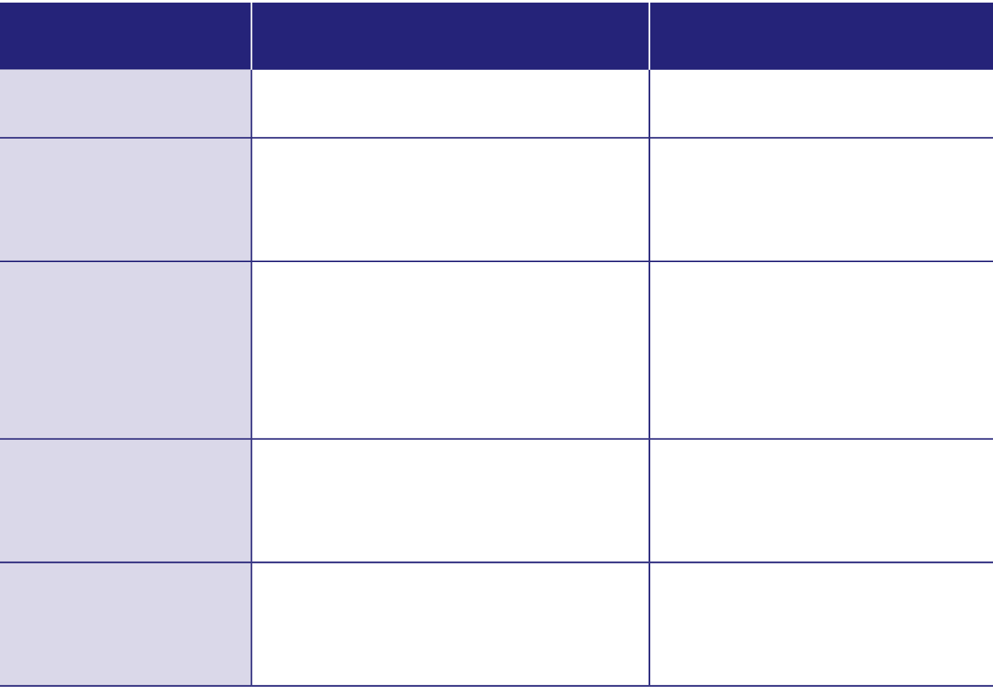
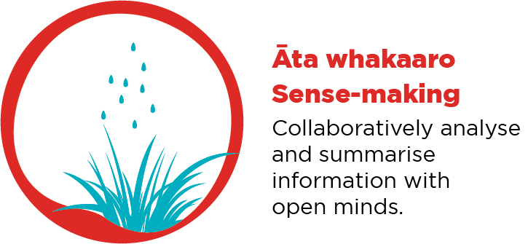
Āta whakaaro: Sense making
Table 3: Examples of defining indicators and thresholds for high risk
RISK INDICATOR
DEFINITION
HIGH-RISK
Lateness
Arriving late for school or class
Five or more incidents per month
Missing classes
Missing selected class periods within a day without an excused reason
Three or more incidents per month
Absenteeism (truancy)
Full day’s absence with or without an excuse. Days out when suspended are also included. Mark the student as absent if most of the classes in a day are missed.
Three or more incidents per month
Inappropriate behaviour
Being sent to office or senior staff for inappropriate behaviour
Three or more incidents per month, in combination with other concerns
Low achievement
Not engaging at the appropriate curriculum level
More than one year level below expected achievement levels in two or more classes
(Check & Connect: Te Hononga manual, p. 33)
Notes:
Reiterate that kaihoe use the monitoring form and their case notes to understand how ākonga are doing in relationship to the set of risk indicators determined by the kaiurungi.
Refer kaihoe to the example of indicators and high-risk thresholds on the screen [Table 3 (p. 33) in the manual].
Explain
Between sessions, kaihoe need to reflect on what the data is saying in relationship to the indicators and high-risk thresholds set for their ākonga and get ready to talk them over at the weekly check. They will use this information to consider the most constructive ways to connect with the ākonga, responding with more intensive responses when that is required. [These will be covered later in this session.]
Every four weeks, kaihoe need to look through all the data to notice any emerging patterns. The text for ‘Āta whakaaro: Sense making’ on pages 50–51 explains how, recommending that ākonga work through the process with the kaihoe so that they can think about what is happening, why, and what a helpful response might be.

Slide 76
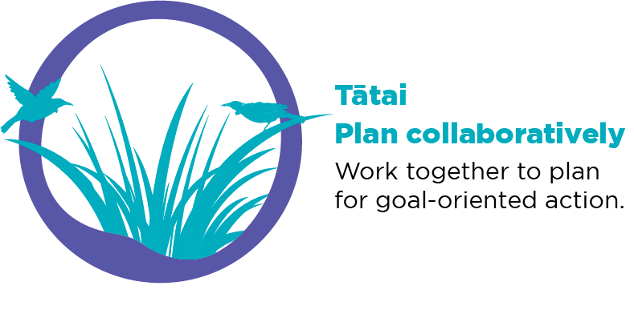
Tātai: Planning collaboratively and setting goals
Goal setting is a core Check & Connect strategy that has the potential to make a great difference to your student’s educational trajectory and life options. It is also helpful for mitigating many of the alterable risk factors that keep students from achieving their educational potential.
(Check & Connect: Te Hononga manual, p. 51)
Notes:
Ask kaihoe to read the statement above and share why they think goal setting is so central to Check & Connect: Te Hononga. Reinforce the message that what matters are the goals that ākonga have for themselves, not the goals we think they should have.
Note the ten reasons for setting goals listed in Table 10 on page 51.
Discuss the relationship between goal setting and motivation: by helping ākonga experience success in achieving goals that matter to them, we can shift the motivation to engage from external forces (“I am being made to go to school”) to intrinsic ones (“It benefits me to go to school”.) That is, by identifying what the ākonga wants to change, we can help establish the motivation for change.
Emphasise that all ākonga need to learn to set and work towards goals but this takes time and ākonga need to experience success before it becomes a habit. For this reason, it is important to:
start with short-term achievable goals
review goals weekly
build upon what is achieved.

Slide 77
Attend – Engage – Invest
Check & Connect offers a framework for helping students move from poor attendance to successful school completion. As a mentor your job is to identify your student’s strengths and needs, and to use this knowledge to adopt strategies and set goals with the student that will support this change. For some, the first step will be to attend school. Once they are attending, you’ll work towards increasing their engagement with school and learning. When they decide that school is important and worth it, your aim will be to interest them in setting and working towards goals with long-term benefits: that is, to invest in their future.
(Check & Connect: Te Hononga manual, p. 53)
Notes:
Read the description of ‘Attend–Engage–Invest’ on the screen with kaihoe.
Look through the examples of responses supporting Attend–Engage–Invest in Table 6 (page 53). Note how the responses become more complex and ‘long-term’ as ākonga progress from attending to engaging and then investing.

Slide 78
Activity: Goal setting
Discuss:
factors that can enable goal setting and factors that can be a barrier
strategies for building on strengths, overcoming barriers, and making goal setting real.
Watch: Check & Connect - Goal setting
Notes:
Play the video.
Discuss: Ask the kaihoe to move into pairs or small groups to discuss:
factors that can enable goal setting and factors that can form a barrier
strategies for building on the enabling factors, overcoming any barriers ,and making goal setting real.

Slide 79
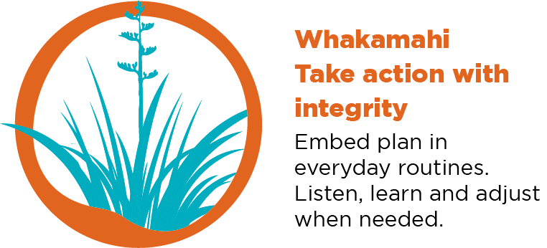
Whakamahi: Taking action and supporting student engagement
As you continue meeting with the student and checking data, you’ll also identify areas in which they can learn to exercise agency (rangatiratanga) in ways that will support their engagement and learning. While some aspects of their lives may currently be outside their control, support them to understand that there is much that is potentially within their control.
(Check & Connect: Te Hononga manual, p. 54)
Notes:
Remind kaihoe that agency promotes engagement. Weekly meetings should be shaped by the ākonga and their needs, interests, and goals. Sometimes, they may be brief but it’s important to persevere. Ongoing meetings, even when things are going well, enable:
ākonga to raise any concerns
kaihoe and ākonga to collaboratively monitor progress
kaihoe to offer positive reinforcement.
Note the practice orientations identified by Massey University’s Pathways to Resilience Research Programme [on page 54 of the manual] and suggest that this is something kaihoe might want to explore with their kaiārahi or peer groups.

Slide 80
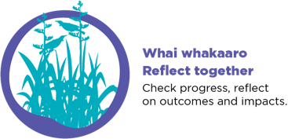
Activity: Whai whakaaro: Reflecting together using problem solving
Step 1: Stop! Think about the problem or risk.
Step 2: What are some choices?
Step 3: Choose one.
Step 4: Do it.
Step 5: How did it work?
Notes:
Prepare for this discussion by printing out copies of the interaction between Sam and Jimmy (manual, pp. 55–56).
Explain that problem solving sits alongside goal setting as a critical strategy that can make a significant difference to learners’ lives. Ākonga need lots of opportunities to learn about these strategies, see them modelled, and practise using them. They need to “start small” and gradually move to addressing bigger and more complex problems requiring more significant and complex solutions.
Briefly talk through the simple problem-solving strategy on the screen [from the manual, p. 55].
Give pairs of kaihoe the handouts with the mentoring interaction and ask them to annotate them with numbers for the five key steps.
Next, read together the explanation of how problem-solving supports strengths-based communication, decision-making skills, and rangatiratanga (independence) (manual, top of p. 57). Once again, ask participants to annotate the handout to identify where these aspects are evident.
Finally, invite the kaihoe to evaluate the effectiveness of the interaction between Sam and Jimmy, commenting on what Sam did to prompt Jimmy to think through the issues for himself.

Slide 81
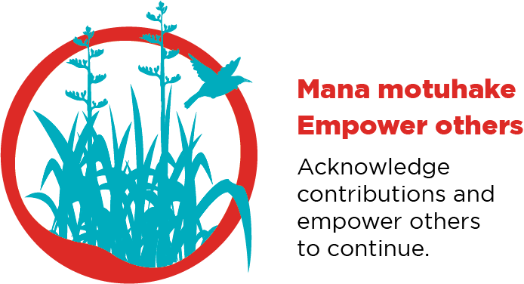
Mana motuhake: Empowering the student
The ways in which you respond to your student and their situation will determine to what extent they feel empowered and supported to exercise mana motuhake (agency, autonomy).
Effective responses:
are intentional, not haphazard
use data as the basis for decisions
are designed in collaboration with the student and whānau
enhance the student’s protective factors
reinforce beneficial behaviours
take account of multiple target areas (e.g., specific classes, home support, extra-curricular activities)
(Check & Connect: Te Hononga manual, p. 57)
Notes:
Explain that when first introduced to Check & Connect: Te Hononga, kaihoe sometimes expect to be following a prescriptive (“cookbook”) approach with ākonga. However, the strength of Check & Connect: Te Hononga is that it is responsive to the strengths, needs, and interests of individual ākonga. Every ākonga will need something different, according to their situation. For this reason, the manual does not set out step-by-step instructions but instead gives guidance about what effective responses look like and examples of them in practice. These are ongoing, evolving over time in response to close monitoring, discussion, and collaborative problem-solving.
Refer the kaihoe to Table 7 (page 58) to get a sense of appropriate ‘basic responses’ in relation to four areas.
Discuss the value of working with others to develop potential responses to different goals and problems, as described in the vignette on page 59.
Encourage kaihoe to find ways to maintain connections with each other so that they can form a community of practice to support one another.

Slide 82
Activity: Levels of response: Intensive responses
Intensive responses are designed to achieve a person–environment fit for the student: they support the student to change their behaviour and encourage whānau, teachers, and school (the environment) to change their policies or practices in ways that encourage participation and engagement. There are many ways of doing this: both student and environment can change.
(Check & Connect: Te Hononga manual, p. 63)
Notes:
Reiterate that the table they just viewed (manual, p. 58, Table 7 ) gives examples of ‘basic’ responses. Explain that the manual also provides examples of ‘intensive’ responses for when ākonga pass a ‘high-risk’ threshold set by the kaiurungi.
Discuss the quote on screen, and the critical importance of everyone [ākonga, whānau, kaihoe, kaiurungi, kaiako] recognising that both the ākonga and school will need to make changes over the two years that an ākonga and kaihoe work together.
Divide participants into three groups and assign each group one of the following: Table 8, the first half of Table 9 [p. 61], or the second half of Table 9 [p. 62]. Ask participants to read through the examples of responses and discuss which clearly require change from an ākonga, which require change from the school, and which require change from both.
Note that these more intensive responses may require kaihoe to advocate with others, such as kaiako or deans, on behalf of the ākonga they are working with. This will require support from their kaiurungi. Their kaiurungi and kaiārahi can both offer support if things are not going well.

Slide 83
Activity: Building connections with whānau
As mentor, you provide a link between school and whānau. Your aim is to build a relationship that will support the educational achievement of your Check & Connect student. Assume that the whānau and the school both want the best for the student, and that by working together they will achieve more than by working in isolation. Engagement occurs through dialogue, mutual problem solving, and shared decision making in relation to expectations, goals, and learning outcomes for the student.
(Check & Connect: Te Hononga manual, p. 64)
What is the purpose of your relationship with whānau?
What should that relationship look like?
Watch: Check & Connect - Working with families
Notes:
Prepare a large sheet of paper with the two questions from the slide and have sticky notes and pens available. [Leave room on the sheet for questions 3 and 4 from the next slide.]
Ask kaihoe to think, pair, and share their response to the questions. You might give them sticky notes to put their responses on the sheet of paper.
Play the video, Working with families.
Ask kaihoe for any additions or amendments to their previous ideas.
Discuss how ākonga are not isolated beings, but members of whānau with shared histories and aspirations. Obvious though this may seem, it is something that ākonga and whānau who took part in Kōrero Mātauranga* felt is often forgotten by educators. For Check & Connect: Te Hononga to be successful, it’s critical to work in collaboration with whānau. For ākonga Māori, this may also mean working with hapū and iwi. Ākonga are far more likely to feel embraced within the school, that they are cared for and valued as part of the school whānau, when they know that the people they whakapapa to or who are very important to them are also valued and embraced and that everyone is working together to support them to achieve their goals.
* https://conversation.education.govt.nz/conversations/education-conversation/what-you-told-us/

Slide 84
Activity: Building connections with whanau – Building trust
The way whānau react and interact differs. There are no hard and fast rules for linking the culture of the whānau with the education context and vice versa, but there are recommended processes. The first recommendation is knowing the background of the whānau and the history of the mana whenua. Other considerations include using moderate language (gentle in tone and pitch), being personable and warm, and being honest. If unfamiliar with cultural protocols then say so, and concede that mistakes may occur.
What are some strategies for building trust and influence with whānau?
What do you need to consider when working with Māori and Pacific whānau?
(Angus Macfarlane, quoted in Check & Connect: Te Hononga manual, p. 65 )
Notes:
Add the two questions from this slide to the large sheet of paper.
Explain that it is the kaiurungi who usually makes first contact with whānau and is responsible for obtaining consent, but kaihoe then play a key role in relationships with whānau.
Ask kaihoe to read pages 65–66 of the manual, thinking particularly about:
the relationship between trust and cultural responsiveness
the impact of prior experience on how whānau engage with the education system
the relationship between the connections you make with whānau and the extent to which ākonga are enabled to feel that they belong at school.
Ask kaihoe to work with their previous partner to:
add their responses to the two questions on this slide on the sheet of paper
discuss, record, and report back on strategies for building trust that they know to be effective.

Slide 85
Building connections with whanau – Communication
Communicating with whānau may not always be easy, and whānau may sometimes find it difficult to communicate with you. Don’t assume a lack of interest. Persist in reaching out. Make it clear that you are in this for the long haul, and that your kaupapa is simply to support their child to achieve educationally. Discover how whānau prefer to communicate, and be flexible.
(He Māpuna te Tamaiti, quoted in Check & Connect: Te Hononga manual, p. 67)
Notes:
Explain that:
the manual lists effective communication strategies on pages 67–68
home visits are always a key strategy for engaging with whānau
kaihoe need to work with their kaiurungi to problem solve any issues with out-of-school visits and meetings
they need to remember to adhere to school policy regarding these visits and meetings.

Slide 86
Ending a Check & Connect: Te Hononga commitment
Typically, a kaihoe will work with an ākonga for at least two years.
Three related considerations are:
Recognising that progress takes time
Knowing when a student needs more intensive support
Recognising when a student is ready to move on.
Notes:
Explain that:
ākonga may be managing serious, complex issues – progress takes time and persistence
if mentoring isn’t working, the ākonga may need to be referred for more individualised support
ending a trusting partnership needs to be carefully negotiated to ensure everyone is comfortable and ready for it to happen
pages 70–72 of the manual provide further information on ending a Check & Connect: Te Hononga commitment.

Slide 87
Te aroturuki me te arotake | Monitoring and evaluation
Monitoring and evaluation play a key role in understanding the impact of Check & Connect for individual students and in determining how well the initiative is being implemented.
Three key aspects of monitoring and evaluation for Check & Connect are:
monitoring its impact for individual students
assessing fidelity of implementation
evaluating the initiative.
(Check & Connect: Te Hononga manual, p. 74)
Notes:
Draw attention to the section of the manual on monitoring and evaluation [pp. 74–77].
Explain that overall responsibility for monitoring and evaluation sits with kaiurungi. It is they who develop systems for monitoring and evaluation and determined what data to collect, when, and how it will be reported. However, they do so using data that kaihoe have gathered:
on the monitoring form (Appendix 4)
on the form for monitoring the impact of Check & Connect: Te Hononga (Appendix 10)
in their case notes.
Their kaiurungi will:
provide kaihoe with access to the school’s student management system (SMS) and training in its use
meet with them regularly to check on progress and provide support
coordinate the collection of outcome data (usually monthly).

Slide 88
Activity: What good looks like
She builds rapport based on trust, which is key for many of these young people, who often have trouble trusting adults in their lives.
Out kaihoe advocates for her mentees, regardless of the concerns/issues raised in the school. She holds her mentees to account, but always lets them know that she is there for them.
Her target setting with the individual students allows them to be self-reflective and ambitious with their future selves.
Our kaihoe is always looking at new connections for the students under her watch, with external or internal school programmes and resources being accessed.
Due to the dynamic nature of college, our kaihoe is always willing to step in and support our pastoral staff with students in trouble or at risk, which is VERY much appreciated by us all.
(Feedback on a kaihoe from a school leader)
Notes:
Explain that the quote on the slide represents feedback from a school leader to the organisation employing this kaihoe. Ask the kaihoe to read the slide, then turn to a neighbour for a brief discussion of how this effective practice exemplifies what they know about the role of a kaihoe.,

Slide 89
Purpose of this session
The purpose of this session was for you to learn about:
Kohikohi: Gathering information
Āta whakaaro: Sense making
Tātai: Planning collaboratively and setting goals
Whakamahi: Taking action and supporting student engagement
Whai whakaaro: Reflecting together using problem solving
Mana motuhake: Empowering ākonga
Basic and intensive responses
Building trust and connections with whānau
Monitoring and evaluation
Ending a Check & Connect: Te Hononga commitment.
Have we achieved our purpose for today? Do you have any questions?
Notes:
Review the purpose for the session.
Ask the kaihoe how well prepared they feel for their role and what further support they may need, especially from their kaiurungi and kaiārahi.
Encourage kaihoe to identify next-step actions based on what they have heard so far. Suggest that, where possible, this include meeting in peer support groups to help each other to learn, develop, address issues, and find emotional support in a role that can have great rewards but also be very demanding.
Encourage kaihoe once again to read and regularly return to the major section of the manual designed for them [Guidance for mentors, pp. 40–73] and to discuss their reading with other kaihoe, their kaiurangi, or their kaiārahi.

